Slide 1



October 2019
Equipment Leasing & Finance Industry Snapshot

Slide 2

Data: Table of Contents
1. Overall Economy
p. 3
2. Investment
p. 8
3. Business Health
p. 11

Slide 3

GDP growth eased to 2.0% in the second quarter, mirroring weakening economic fundamentals amid rising uncertainty.
Economy
Real GDP Growth
Annualized Percent Change from Previous Quarter
30-Year Quarterly Average = 2.5%
+2.0%
Source: U.S. Bureau of Economic Analysis, Keybridge LLC
Notes:
The U.S. economy expanded 2.0% (annualized) in Q2, decelerating from 3.1% growth in Q1 and slower than the 30-year quarterly average of 2.5%.
Slower growth mirrors dimming economic fundamentals, driven by trade tensions abroad and a worsening global economic outlook.
On the positive side, consumer spending (the backbone of the U.S. economy) recovered in the second quarter after tepid growth in Q1.
However, a weakening manufacturing sector and waning business confidence will dampen growth prospects through the rest of 2019.
Overall, the Foundation projects the U.S. economy to grow 2.2% in 2019, down from the Foundation's previous estimate of 2.5% in July.

Slide 4
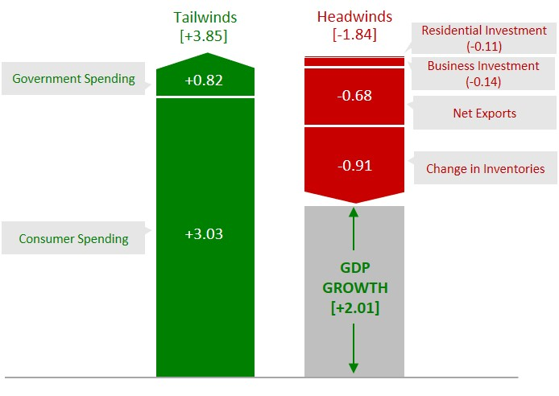
Growth was driven primarily by consumer spending in Q2, while investment and net exports dragged on the U.S. economy.
Economy
Tailwinds & Headwinds
Contributions to GDP Growth by Sector
Source: U.S. Bureau of Economic Analysis, Keybridge LLC
Notes:
Economists often use a simple formula to describe the U.S. economy: “C + I + G + NX” (consumption + investment + government spending + net exports). With this in mind, the two biggest factors contributing to growth in the first quarter of 2019 were C and G. However, net exports and investment were drags on the economy.
Consumer spending recovered in Q2 after its second weakest growth since 2013 last quarter, expanding 4.6% (annualized) and providing the vast majority of overall economic growth. Given consumption’s outsized share of the U.S. economy, consumer spending will likely keep the economy “in the black” over the remainder of the year.
Investment dropped 6.3% (annualized) in the first quarter, driven by an 11.1% decline in nonresidential structures. Equipment investment grew at a tepid 0.8% in Q2 after contracting slightly in Q1, but software investment expanded 3.6% (though at the slowest rate in two years). A drop in inventories shaved nearly a full percentage point off GDP growth after adding half a point last quarter.
Government spending expanded 4.8% (annualized) and added 0.82 of a percentage point in Q2, the strongest growth in a decade. Growth was largely driven by federal spending, particularly nondefense spending, but state and local spending (which makes up roughly two-thirds of government expenditures) grew at a solid 2.7% annualized rate.
Net exports fell in Q2, reducing GDP growth by 0.68 percentage and posting its third negative contribution in a year. Exports fell 5.7% in Q2 and imports remained flat.

Slide 5
Top Economic Headwinds & Tailwinds
ECONOMIC TAILWINDS
Despite being late in the current business cycle, consumers exhibit low financial stress, as charge-off and delinquency rates for all loans remain exceptionally low.
While certain corners of the consumer credit market are showing signs of stress, consumers appear well-positioned to continue managing debt effectively.
Low Consumer Financial Stress
Consumer spending bounced back in Q2 — growing 4.6% on an annualized basis in real terms — after weak Q1 growth.
While it is unlikely consumers will maintain this strong spending pace, there are few signs of a pronounced slowdown or near-term recession.
Robust Consumer Spending
ECONOMIC HEADWINDS
Global manufacturing activity has suffered due to slowing global growth and escalating trade tensions between the United States and China.
Manufacturing in the United States, China, and Europe have slowed significantly as demand wanes, and is unlikely to recover in 2019.
Global Manufacturing Slowdown
Economic uncertainty has spread throughout the global economy, severely weighing on U.S. business confidence.
U.S. small businesses are more upbeat but are showing signs of concern; a trend that could portend the end of the current business cycle if it continues.
Waning Business Optimism
Source: Q4 2019 Equipment Leasing & Finance U.S. Economic Outlook
Notes:
Tailwinds:
Low Consumer Financial Stress
Despite the late stage of the current business cycle, consumers continue to exhibit low financial stress by most measures.
Charge-off rates for all loans hover near post-recession lows while delinquency rates reached a historic low in Q2.
The share of consumer debt in any stage of delinquency reached the lowest level since 2006, and the share of outstanding debt that is severely delinquent has been at or below 2% since early 2015.
The share of credit card credit that is delinquent 90+ days remains well below levels prior to the Great Recession, despite recent increases. When measured as a share of disposable income, credit card debt remains low.
Student loan debt continues to grow, and delinquency rates have risen for subprime auto loans over the past year.
Overall, however, consumer financial stress is quite low, which bodes well for consumers heading into 2020.
Robust Consumer Spending
Consumer spending, which accounts for more than two-thirds of U.S. GDP, grew by 4.6% in Q2 after weak Q1 consumer activity that indicated the potential for a sustained consumer slowdown.
Spending on durable goods (which is usually where consumers first pull back when incomes are feeling pinched) was especially strong at 13% growth, the fastest pace in six years.
While it is perhaps unlikely that consumers can maintain such strong spending, there are few signs of a pronounced slowdown: debt levels remain manageable for most consumers and consumer confidence remains elevated.
These factors should help support healthy spending for the rest of the year and make a near-term recession unlikely.
Headwinds:
Global Manufacturing Slowdown
Global manufacturing activity has taken a massive hit from slowing global growth and escalating trade tensions between the U.S. and China.
In the United States, for example, the manufacturing sector was officially in a recession after the completion of the second quarter. Though there have been signs that the contraction may have troughed in August, it is not yet clear if a recovery is underway, as the ISM Manufacturing PMI fell into contractionary territory in August for the first time since 2016.
China is also experiencing manufacturing weakness, having seen industrial production growth fall to the lowest in over a decade, and ongoing stimulus efforts have done little to prop up the highly-indebted domestic manufacturing sector.
Meanwhile, the German manufacturing sector has plunged into its deepest recession in a decade and has sparked concerns that the rest of the German economy will contract as well. Given the German economy’s size compared to the rest of Europe, a recession there will likely spread throughout the continent.
Combined with a trade war with the United States, global industrial weakness will likely persist into 2020.
Waning Business Optimism:
Uncertainty spreading throughout the global economy that has been partially fueled by the U.S. trade war with China is increasingly weighing on U.S. business confidence.
For example, the Business Roundtable’s CEO Economic Outlook Index declined for the sixth consecutive quarter in September, driven by worsening geopolitical and trade uncertainty.
Similarly, the National Association of Manufacturers’ (NAM) Manufacturing Outlook Index dropped to its lowest point in three years in Q3.
While U.S. small businesses are more upbeat, there is still reason for concern.
According to NFIB, small business’s sales expectations for the next three months are near their lowest point since the 2016 election.
The PayNet SBLI pulled back 5.5% on an annual basis in August but remains in the top 10% of readings.
If small businesses optimism continues to fall, businesses both large and small could pull back on hiring plans — which could portend the end of the current business cycle.

Slide 6
Additional Factors to Watch
China Relations?
Relations between the United States and China remain strained, as what has started as a trade war has transformed into strategic engagement on multiple fronts.
Even if the U.S. decides it wants a trade deal in the near term, it is unlikely to reduce tension in areas beyond trade.
1
Housing Market Improvement?
While the housing market has been sluggish over the past two years, recent data suggest there is potential for a modest improvement.
Although housing input costs are elevated and have weighed on housing affordability, housing activity picked up amid sub-4% mortgage rates.
2
Employment Outlook?
The labor market has been the growth engine for the U.S. economy, as U.S. employers have added to their payrolls for nearly 110 months.
However, job growth has slowed markedly in 2019, particularly in manufacturing and construction, and is unlikely to accelerate and may slow further.
3
Equity Market Turmoil?
The past year has been particularly volatile for U.S. financial markets, reflecting geopolitical and economic uncertainty, and a sharp decline could cause a pullback in consumer spending.
However, there is evidence that global investors see U.S. markets as a safe haven, which could foster the bull market’s continuation.
4
Source: Q4 2019 Equipment Leasing & Finance U.S. Economic Outlook
Notes:
Additional Factors to Watch
China Relations?
Relations between the United States and China continue to be strained.
The Trump administration has alternated from threatening ever higher tariffs to showing a willingness to make concessions, leading to occasional wild swings in U.S. equity markets.
Both countries have drafted “blacklists” intended to prevent specific businesses from operating in the other’s country.
The U.S. has also threatened third-party nations with punishment if they source hardware from Chinese telecom firms.
Meanwhile, China is contending with pro-democracy protests in Hong Kong that have threatened the “one country, two systems” rule of law.
In response, both the U.S. House and Senate have taken up bills to ramp up pressure on authorities in Beijing.
What began as a trade war between the world’s largest economies has grown into a strategic engagement on several fronts.
Even if the U.S. administration decided to make a trade deal in the near term, the chances that China will enact meaningful changes to its economy and political governance are slim, and geopolitical instability will likely persist.
Housing Market Improvement?
While the housing market has been sluggish over the past two years, recent data suggest there is potential for a modest improvement in the months ahead.
On the downside, a variety of headwinds facing the industry: buildable lots remain scarce, an exceptionally tight labor market has contributed to labor shortages, and trade tensions have put upward pressure on the cost of materials.
However, in August, housing starts improved 7% from year-ago levels and permits experienced the strongest growth since March 2017.
Moreover, 30-year fixed mortgage rates have been below 4.0% since mid-June, due in part to the Fed cutting rates in Q3. This likely contributed to New Home Sales jumping 7% in August and Existing Home Sales increasing at the fastest pace since May 2017.
While limited availability of affordable housing units will continue to be a drag on the market, a modest improvement in the housing sector is a possibility.
Employment Outlook?
The labor market has long been a growth engine for the U.S. economy, as U.S. employers have added to their payrolls for a record 108 consecutive months.
The strong job market is also reaching demographic groups that are typically on the sidelines during an expansion.
Businesses report that finding and retaining qualified workers is among their most pressing near-term challenges, suggesting that hiring should remain positive over the coming months.
However, job growth has slowed in 2019, particularly in key sectors such as manufacturing and construction.
While the labor market is not poised for collapse, job growth is unlikely to accelerate and may slow further, especially if a worsening trade war affects firms’ hiring plans.
Equity Market Turmoil?
The past year has been particularly volatile for U.S. financial markets, reflecting significant geopolitical and economic uncertainty.
The stock market is currently near an all-time high but appears to be overvalued by some measures (e.g. the S&P 500 Shiller Cyclically-Adjusted Price/Earnings Ratio was 29 in August, nearly 5 points above its 10-year average).
Given that stock market performance is strongly correlated with consumer confidence, if a significant correction were to occur, a pullback in consumer spending would be a likely consequence.
However, foreign investors facing a deteriorating global outlook and negative interest-bearing investment opportunities abroad appear to be viewing U.S. markets as a safe haven of sorts.
As such, equity markets warrant extra attention throughout the final quarter of 2019 and into the new year.

Slide 7
Projections for Key Economic Indicators
Indicator | 2017 | 2018 | 2019 Quarterly Estimates |  |  |  | 2019e
 |  |  | Q1e | Q2e | Q3e | Q4e
Real GDP (SAAR %) | 2.4% | 2.9% | 3.1% | 2.0% | 1.6% | 1.8% | 2.2%
Real Investment in Equipment & Software (SAAR %) | 5.5% | 7.7% | 3.5% | 2.1% | 1.7% | 1.5% | 3.9%
Inflation (year-on-year %) | 2.1% | 2.4% | 1.6% | 1.9% | 1.7% | 1.8% | 1.8%
Federal Funds Target Rate (upper bound, end of period) | 1.5% | 2.5% | 2.5% | 2.5% | 2.00% | 1.75% | 1.75%
10-year Treasury Rate (end of period) | 2.40% | 2.70% | 2.40% | 2.00% | 1.68% | 1.35% | 1.45%
Total Payroll Growth (thousands) | +2153 | +2679 | +521 | +456 | +470 | +425 | +1872
Source: Q4 2019 Equipment Leasing & Finance U.S. Economic Outlook
Notes:
GDP: After achieving strong 3.1% growth in Q1, the U.S. economy appears to be slowing, but consumer spending remains solid.
Consumer spending grew 4.6% in Q2, as payrolls continue to grow, annual wages remain elevated, and unemployment remains near historic lows.
Business investment contracted, given global economic uncertainty surrounding manufacturing sector health and trade tensions weighing on business optimism.
Residential investment contracted for the sixth consecutive quarter due to rising input costs for homebuilders driving a lack of affordable housing.
Exports fell sharply for the second quarter in the past year and will likely continue to fall, as global demand for manufactured goods wanes and the dollar remains strong.
Investment: As expected, investment growth slowed in the second quarter. As such, our annual forecast for equipment and software investment growth remains at 3.9%, roughly half the 7.7% pace of growth experienced in 2018.
Inflation: Although headline inflation remains muted, core inflation has risen in the second half of 2019. The headline has averaged 1.7% in 2019, compared to 2.4% in 2018, due in large part to muted energy prices. Meanwhile, core CPI inflation has accelerated for three consecutive months and reached 2.4% in Q3, the highest rate since 2008. Looking ahead, wage growth near 3%, combined with higher tariffs on consumer goods could apply further upward pressure on core inflation.
Interest Rates: After holding interest rates steady through the first half of 2019, the Federal Reserve reduced the upper bound of the federal funds rate from 2.5% to 2.0% in Q3 and left open the possibility of more cuts in Q4.
Job Growth: Despite the unemployment rate holding at or below 4.0% since March 2018, the U.S. economy continues to experience robust payroll growth. However, payroll growth is likely to slow through the end of the year, as 2019 job growth has averaged just 158,000 nonfarm jobs per month, compared to the 223,000 monthly pace in 2018.

Slide 8
Business investment contracted in Q2 for the first time since early 2016.
Investment
Business Investment
Real Nonresidential Fixed Investment, Percent Change from Previous Quarter (SAAR)
-1.0%
Source: U.S. Bureau of Economic Analysis
Notes:
Business investment fell 1.0% (annualized) in Q2, after moderate 4.4% annualized growth in Q1.
Business investment (also known as nonresidential fixed investment) consists of three elements: equipment, software and R&D, and non-residential structures (e.g., commercial buildings, oil platforms).
Equipment: +0.8% (annualized) (up from -1.0% in Q1)
Software / R&D: +3.6% (annualized) (down from +12% in Q1)
Non-res structures: -11.1% (annualized) (down from +4.3% in Q1

Slide 9
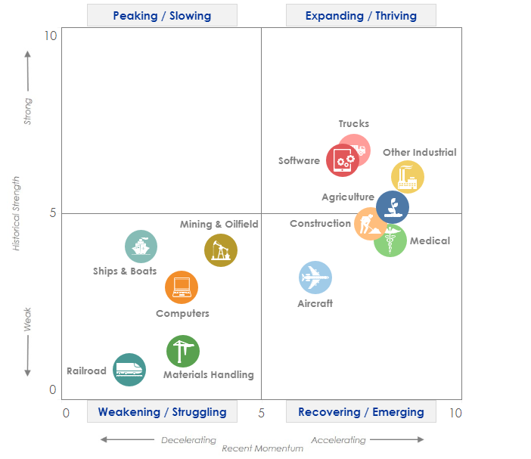
Equipment investment growth should remain weak over the remainder of the year, but momentum has improved somewhat since the Q3 Snapshot.
Investment
Equipment & Software Investment
Momentum Monitor (Equipment Vertical Performance Matrix)
Source: Q4 2019 Equipment Leasing & Finance U.S. Economic Outlook
For more information on how to use the Momentum Monitors, see final slide.
Notes:
Equipment and software investment decelerated for the third consecutive quarter in Q2, growing only 2.1% (annualized). E&S investment will likely continue decelerating through the end of 2019.
Based on the latest data, the following equipment verticals show potential promise in the next 3-6 months:
Software
Other Industrial
Agriculture
Medical
The following equipment verticals may struggle in the next 3-6 months:
Materials Handling
Railroad
Mining & Oilfield
Ships & Boats
Computers
Notes about the Equipment Vertical Performance Matrix: The matrix above summarizes the current values of each of the 12 Equipment & Software Investment Momentum Indices based on two factors: Recent Momentum (x-axis) and Historical Strength (y-axis). The matrix is comprised of four quadrants according to each vertical’s “recent momentum” and “historical strength” readings (see last slide in deck for a description of these terms):
If a vertical is located in the top-left quadrant, its momentum reading is higher than average, but positive movement has slowed (and perhaps reversed) in recent months — suggesting that investment levels may fall over the next 1-2 quarters.
Verticals located in the bottom-right quadrant, however, have momentum readings that are below average, but recent movement shows promise — suggesting that investment levels may rise over the next 1-2 quarters. This makes them potentially attractive targets for new leasing and finance opportunities.

Slide 10
Equipment and software investment is projected to expand by a modest 3.9% in 2019.
Investment
Real Equipment & Software Investment Growth
Q/Q Percent Change, SAAR
Forecasts
Source: U.S. Bureau of Economic Analysis; Projections from Keybridge
Notes:
The Foundation expects equipment and software investment to grow at a 3.9% pace in 2019, roughly half the 2018 pace of 7.7%.
(Note that while it may seem counterintuitive for projected annual E&S investment growth in 2019 to exceed the pace of growth in any individual quarter in 2019, this result stems from the robust 8.2% growth in Q4 2018, which provided a strong “jump-off point” for 2019.)
While equipment and software investment experienced solid 7.7% growth in 2018, investment is likely to continue decelerating as the industry faces significant headwinds, such as waning business confidence brought on economic and geopolitical uncertainty.

Slide 11

New business volume growth in 2019 is on track to beat 2018 levels after recovering from a slow first half of the year.
Bus. Health
MLFI-25 New Business Volume
Through August*, investment is up 3.4% relative to year-ago levels
Billion Dollars
*2019 data through August – projected through end of year using a simple year-to-date extrapolation.
Source: ELFA MLFI-25
Notes:
According to ELFA’s Monthly Leasing and Finance Index, new business volume expanded 4.1% in 2018 compared to the year prior. After five consecutive months of negative year-over-year growth in the first half of 2019, growth in cumulative new business volume significantly improved in in the third quarter and is up 3.4% compared to year-ago levels.
*Note: ELFA's Monthly Leasing and Finance Index (MLFI-25) reports economic activity from 25 companies representing a cross section of the equipment finance sector.

Slide 12
In August, new business volume grew at a modest 3.4% yearly pace, slowing down significantly from growth in April through July.
Bus. Health
MLFI-25 New Business Volume
Y/Y Percent Change
3.4%
Source: ELFA MLFI-25
Notes:
On an annual basis (i.e., compared to growth experienced in August 2018), new business volume rose 3.4% in August — a deceleration from the double-digit growth experienced in April, May, and July.

Slide 13
Additionally, the Monthly Confidence Index dropped 4.2 points to 54.7 in September, suggesting the industry outlook is deteriorating.
Bus. Health
Monthly Confidence Index: Equipment Finance Industry (MCI-EFI)
54.7
Source: ELFF MCI-EFI
Notes:
Confidence among key executives has dropped significantly from 2018 levels, falling to 54.7 in September and down over 16% from year-ago levels.
In September, only 20% survey respondents categorized the economy as “excellent,” down from 36.7% in August. However, no respondents believe the economy is “poor,” down from 3.3% the prior month.
Additionally, over three quarters of executives believe business conditions will remain the same over the next four months, little changed from August. Meanwhile, 13.8% believe business conditions will worsen, up from 6.7% the previous month.
Note: The MCI-EFI is produced by ELFF each month using a survey of key industry executives from banks, captives, and independent firms. It is designed to provide a qualitative assessment of both the prevailing business conditions and expectations for the future.

Slide 14
The PayNet Small Business Lending Index dropped 5.3 points in August, pointing to potentially weaker lending activity.
Bus. Health
PayNet Small Business Lending Index (SBLI)
January 2005 = 100
SBLI
SBLI 3MMA
142.2
Source: PayNet
Notes:
PayNet’s Small Business Lending Index (“SBLI”) fell 5.3 points to 143.1 in August and down 5.5% year-over-year. The SBLI 3-month moving average down 2.4% on a yearly basis, the first month in over two years in which it fell from year-ago levels.
It is unlikely that small businesses will match their performance last year. However, unlike large businesses, they are more insulated from global headwinds and should be less affected by trade risks.

Slide 15
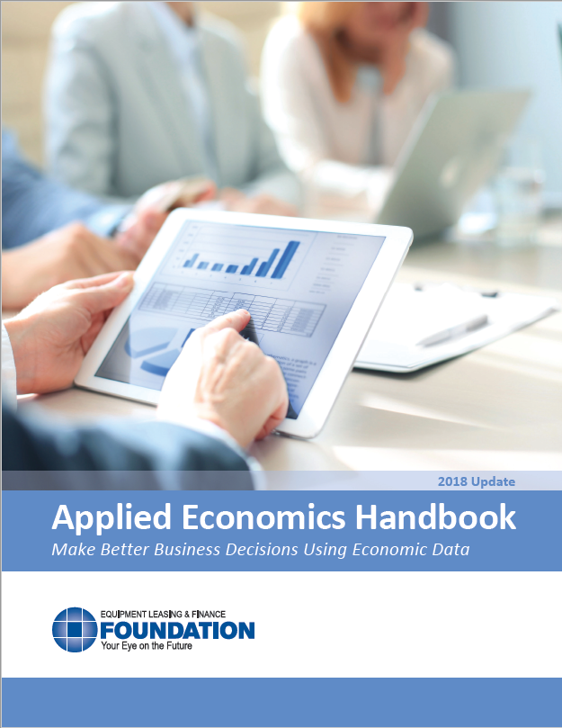
EQUIPMENT LEASING & FINANCE FOUNDATION
For more information on how you can use this information in your business, download the recently-updated Applied Economics Handbook.
Reports are available to download at www.store.leasefoundation.org
Notes:
Note: the recently-updated Applied Econ Handbook is available for free on the Foundation’s website.

Slide 16
Notes
*U.S. Equipment & Software Investment Momentum Monitor (Slide 9)
Published monthly, the U.S. Equipment & Software Investment Momentum Monitor is a set of leading indicators for the equipment sector consisting of indices for various equipment and software investment verticals. These indices are designed to identify turning points in their respective investment cycles with a 3–6 month lead time.
Each index is comprised of between 15 to 20 high-frequency indicators and is statistically optimized to signal turning points in the investment cycle without giving false readings of shifts in momentum.
The Momentum Monitor covers 12 equipment and software verticals as defined by the U.S. Department of Commerce Bureau of Economic Analysis. These verticals include aircraft, agriculture machinery, computers, construction machinery, materials handling equipment, medical equipment, mining and oilfield equipment, other industrial equipment, railroad equipment, ships and boats, software, and trucks.
“Recent Momentum" represents the degree of an indicator's recent acceleration or deceleration in the past month relative to its average movement during the previous 3 months. Ratings closer to "0" represent an indicator that is rapidly decelerating, while ratings closer to “10” represent an indicator that is rapidly accelerating.
"Historical Strength" represents the strength or weakness of an indicator in the past month relative to its typical level since 1999. Ratings closer to "0" represent an indicator that is weaker than average, while ratings closer to "10" represent an indicator that is stronger than average.

