Slide 1
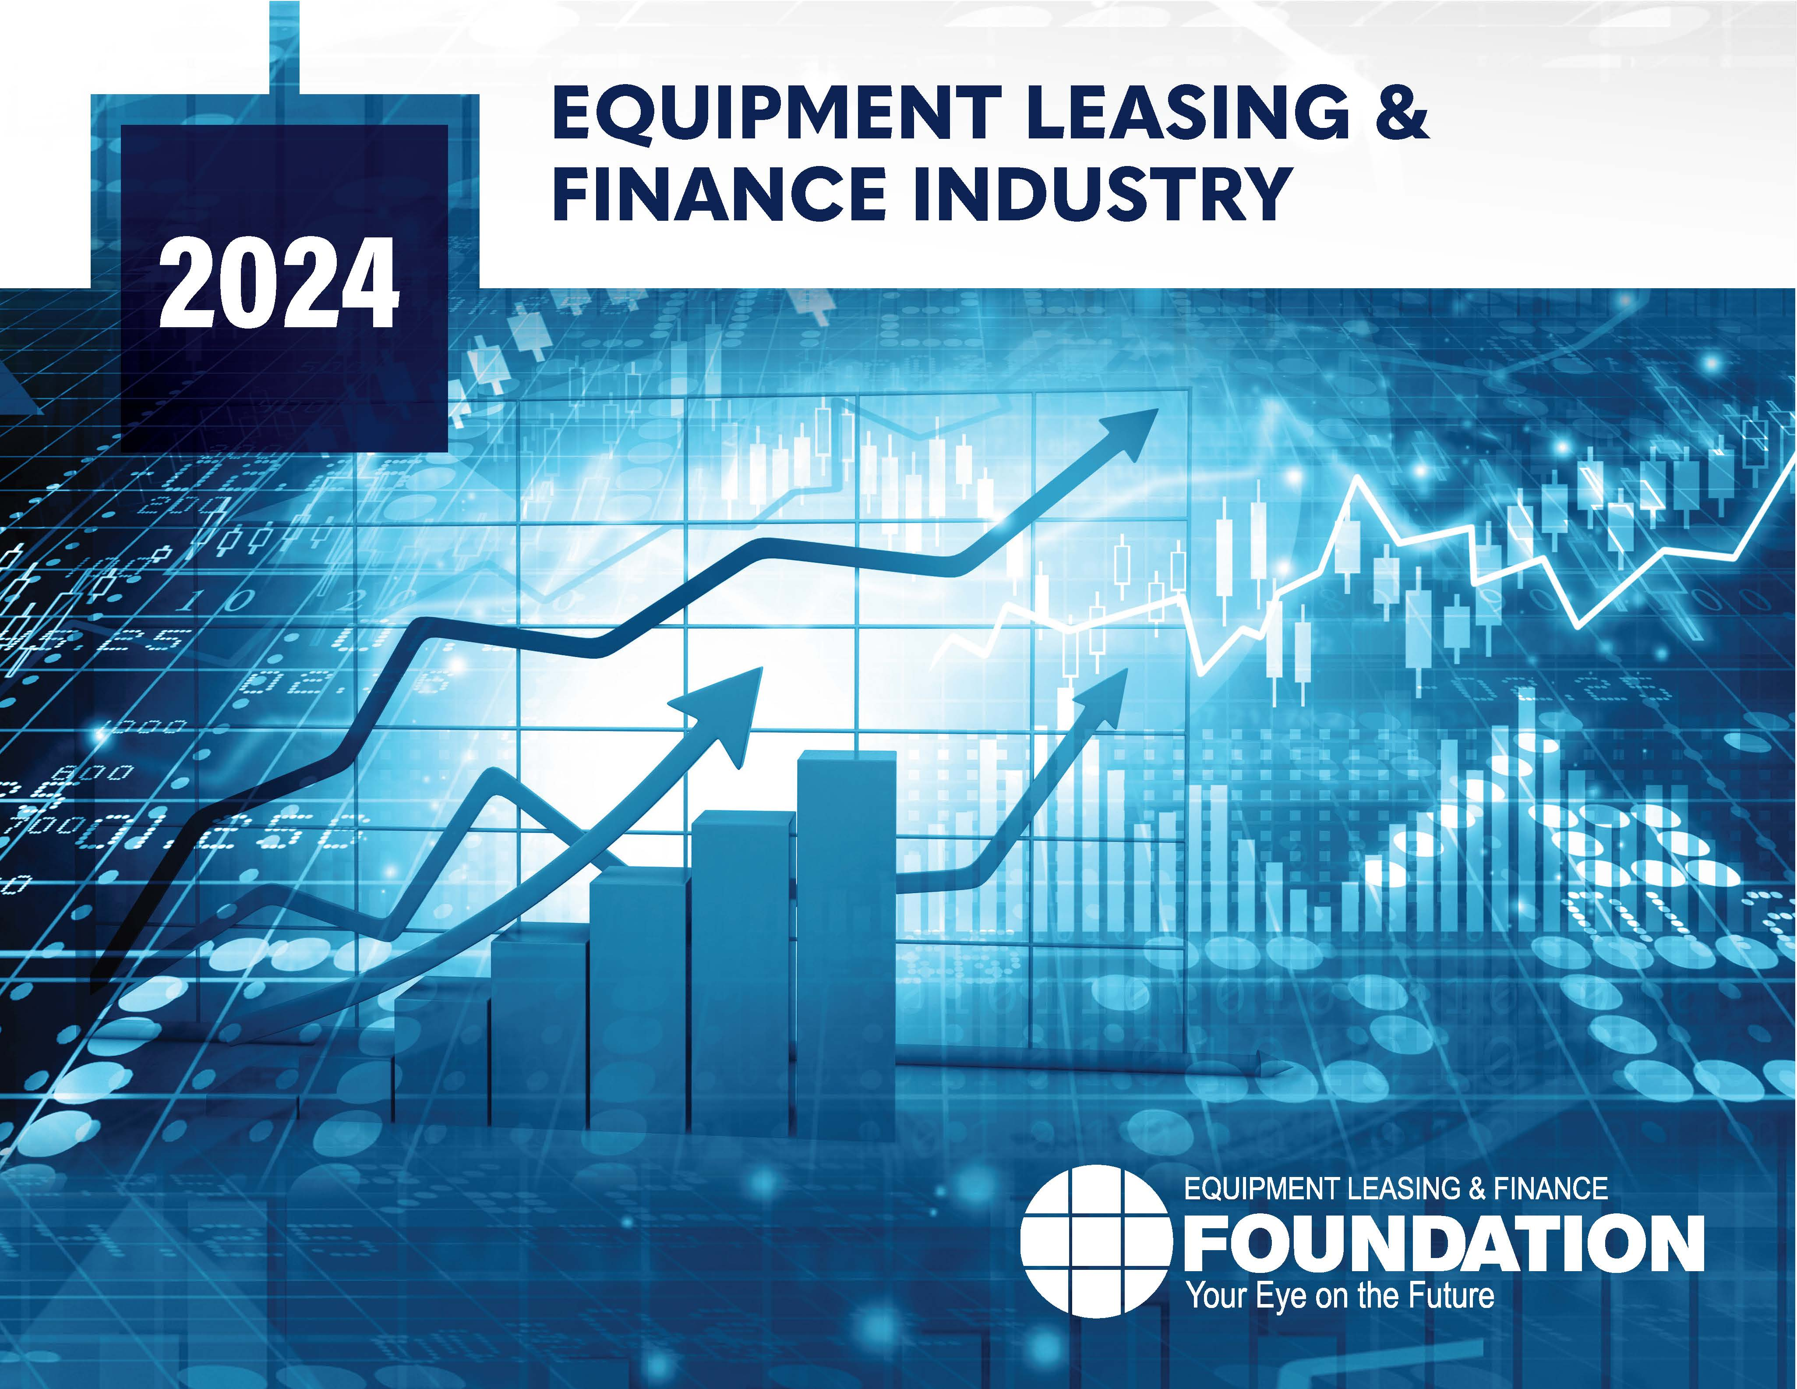


Snapshot of the Equipment Leasing and Finance Industry and U.S. Economy
July 2024
Prepared For:
Equipment Leasing & Finance Foundation
Prepared By:
Keybridge LLC

Slide 2
Data: Table of Contents
1. Overall Economy
p. 3
2. Investment
p. 9
3. Business Health
p. 12

Slide 3

The U.S. economy expanded at 1.4% (SAAR) in the first quarter of 2024, a slowdown from 3.4% growth in Q4 2023.
Economy
Real GDP Growth
Annualized % Change from Prior Quarter
Forecast
30-Year Quarterly Average = 2.6%
35.3%
1.4%
-29.9%
Source: U.S. Bureau of Economic Analysis, Keybridge LLC
Notes:
The U.S. economy had another quarter of growth in Q1. Consumer spending, business and residential investment, and government spending drove the expansion, while inventories and trade were net drags.
Consumer spending was, yet again, the largest driver of economic growth in Q1. Looking ahead, consumer demand may slow for multiple reasons, including weaker disposable income growth, “inflation fatigue,” and rising financial stress, especially among younger and lower income households. However, the labor market remains strong, which bodes well for consumers in at least the short term.
Overall, a recession in 2024 remains unlikely, but a return to strong economic growth is also unlikely. A soft-landing looks like the best bet, but is it a fait accompli?

Slide 4
Q1 growth was primarily driven by consumer spending, supported by a boost in government spending and business and residential investment.
Economy
Tailwinds & Headwinds
Contributions to GDP growth by sector
TAILWINDS
HEADWINDS
[+2.47]
[-1.07]
+0.31
Change in Private Inventories
Government Spending
-0.42
Business Investment
+0.59
-0.65
Net Exports
Residential Investment
+0.59
NET CHANGE
IN GDP
+1.4
Consumer Spending
+0.98
Source: U.S. Bureau of Economic Analysis, Keybridge LLC
Notes:
Economists often use a simple formula to describe the U.S. economy: “C + I + G + NX” (consumption + investment + government spending + net exports). With this in mind, the primary drivers of Q1’s expansion were consumer spending, government spending, business investment, and residential investment. Private inventories and net exports contributed negatively to GDP growth.
Consumer spending expanded 1.5% (annualized) in Q1. Spending on goods and services has bifurcated, with services growing at a solid 3.3% annualized pace and durable and nondurable goods contracting 4.5% and 1.1% annualized, respectively.
Government spending softened in Q1 (1.8% annualized). Lower spending was driven by a contraction in national defense spending and a slowdown in nondefense and state and local spending.
Equipment investment increased 1.6% annualized, an uptick after contracting for three of four quarters in 2023. Information processing and industrial equipment lead growth (12.8% and 6.8% annualized) while transportation equipment continues to contract (-18.1% annualized). Software investment, by contract, expanded 11% annualized.

Slide 5

Special Topic: Economic Consequences of the 2024 Election
The Q3 Economic Outlook and Industry Snapshot were developed prior to Vice President Harris becoming the presumptive Democratic party nominee. At present, with a short campaign, it is a reasonable assumption that a Harris Administration would closely resemble a second Biden term in many respects, including the five areas discussed below.
Candidate Economic Policy Breakdown
Taxes
Trump will likely extend the 2017 Tax Cuts and Jobs Act (TCJA) and may pursue further reductions to the corporate tax rate (currently 21%). Biden, on the other hand, is expected to extend the TCJA for individuals earning less than $400K/year, expand the Earned Income Tax Credit (EITC) and child tax credits, and will likely attempt to increase corporate tax rate.
Trade Policy / Tariffs
Biden supports targeted tariffs, such as the 100% tariff on Chinese EVs and solar panels. In contrast, Trump has proposed a 10% tariff on nearly all imported goods. Some U.S. companies would benefit from protectionist trade policies, but economists are overall skeptical of tariffs as they raise prices for Americans and put upwards pressure on inflation.
Industrial Policy
  The IIJA, CHIPS Act, and IRA were costly but have positively impacted the industrial economy and are expected to continue to drive construction and manufacturing growth. Biden would maintain these acts as a key accomplishment of his first term. Trump may support some aspects of these initiatives, but has criticized others, including tax incentives for EVs and renewable energy.
Labor Market
Both administrations are likely to significantly curb immigration, though Biden’s approach is expected to be less restrictive. Lower levels of immigration could result in a tighter labor market and higher wages, particularly within immigrant-dominant workforce sectors. Immigration is set to play an increasingly important role in the U.S. economy as Baby Boomers retire.
Regulation
A second Trump term would likely see a reduction in regulations, particularly in the energy and environment space. Conversely, Biden is expected to push for more stringent regulations. Both administrations may have less regulatory power, however, due to recent Supreme Court decisions.
Source: 2024 Q3 Equipment Leasing & Finance U.S. Economic Outlook
Notes:
Presidential Election
Taxes –
Trump: Extend provisions of the 2017 Tax Cuts and Jobs Act (TCJA). Has also hinted at favoring further reductions to the corporate tax rate, currently set at 21%.
Biden: Extend TCJA for individuals earning <$400K/year. Expand EITC and child tax credits. Increase corporate tax rate to 28% and the min. corporate tax rate for $1B+ corp. to 21%.
Trade Policy / Tariffs –
Biden has advocated for using targeted tariffs, such as the 100% tariff on Chinese EVs and solar panels. By contract, Trump has proposed a 10% tariff on nearly all imported goods and intends to use the revenue to partially offset the cost of his tax plan.
The party that bears the cost of a tariff is situationally dependent, but it is typically the exporter, supplier, or consumer. For this reason, most economists are skeptical of tariffs: they raise prices for Americans and put upward pressure on inflation.
Industrial Policy –
The IIJA, the CHIPS Act, and the IRA, while expensive, have had a positive effect on the industrial economy to date and are expected to continue driving construction and manufacturing.
Biden would clearly favor maintaining them and views them as a key accomplishment in his first term. Trump may support some of them but has criticized others, including tax incentives for electric vehicles and renewably energy.
Labor Market –
Both the Biden and Trump administrations would curb immigration significantly, though Biden’s agenda is expected to be less restrictive.
Lower levels of immigration would likely result in a tighter labor market and higher wages, particularly within immigrant-dominant workforce sectors.
Regulation –
Trump: A second term would likely bring a reduction in regulations, including but not limited to the energy and environment space.
Biden: Biden would likely continue to push for more stringent rules.
Both administrations may have less regulatory power, however, due to recent Supreme Court decisions

Slide 6

Special Topic: Is a Soft-Landing Fait Accompli?
The U.S. Economy Appears on Track to Tame Inflation without Triggering a Recession
Fed Intervention “Landing” Outcomes
Blinder analysis of the economic outcomes of Fed interest rate hikes
Hard Landing
due to
Fed Policy
Soft Landing
“If the need to fight inflation is not too extreme, and serious adverse events like war or supply shocks do not intervene, the Federal Reserve has shown itself capable of engineering a landing that either does not induce a recession or, if it does, induces a small one.”
- Alan Blinder
November 2023
3
3
3
11
Rate Hike Cycles
1965-2019
Hard Landing
due to
External Shocks
2
3
Softish Landing
Progress Towards a Soft Landing
The likelihood of a September rate cut has increased as both the Consumer Price Index (CPI) and Personal Consumption Expenditures Price Index (PCE) cooled in May, with CPI falling M/M in June for the first time in two years.
Over the last 18 months, the Fed has done an admirable job reducing inflation while maintaining labor market stability, adding an average of 242,000 jobs per month.
Downside risks to a soft landing include softening consumer demand and rising financial distress, though economists still place the odds of a soft landing (60-70%) above that of a hard landing.
Source: Blinder, A. “Landings, Soft and Hard: The Federal Reserve, 1965-2022,” Journal of Economic Perspectives, Winter 2023; 2024 Q3 Equipment Leasing & Finance U.S. Economic Outlook
Notes:
While traditionally reliable recession indicators signaled a downturn after the Fed rapidly raised rates in 2022–23, in retrospect the unique nature of the pandemic and its second-order economic effects may have caused some of these indicators to produce false signals.
Currently, economists place the odds of a soft landing at 60–70%, and while the “experts” are by no means infallible given the complexity of the U.S. economy and the potential for unforeseen events, the economy’s resiliency over the last 18 months suggests that the Fed may have threaded the needle after all. Time will tell, but the Foundation does not anticipate a downturn in 2024.

Slide 7
Projections for Key Economic Indicators
Indicator | 2022 | 2023e | 2024 Quarterly Estimates |  |  |  | 2024e
 |  |  | Q1 | Q2e | Q3e | Q4e
Real GDP (SAAR %) | 1.9% | 2.5% | 1.4% | 1.5% | 1.5% | 1.8% | 2.3%
Real Investment in Equipment & Software (SAAR %) | 7.9% | 3.0% | 5.1% | 4.5% | 2.9% | 3.7% | 3.7%
Inflation (year-on-year %) | 6.4% | 3.3% | 3.2% | 3.0% | 2.8% | 2.7% | 2.7% (end of year)
Federal Funds Target Rate (upper bound, end of period) | 4.50% | 5.50% | 5.50% | 5.50% | 5.25% | 5.00% | 5.0% (end of year)
Total Payroll Growth (thousands) | 4,793 | 3,013 | 802 | 532 | 475 | 425 | 2,234
Source: 2024 Q3 Equipment Leasing & Finance U.S. Economic Outlook
Notes:
GDP: We expect real GDP to grow by 2.3% in 2024, a relatively healthy year of economic growth.
Investment: We expect E&S investment to be slightly stronger in 2024 than 2023, despite pressure from elevated interest rates.
Inflation: We expect inflation to continue to decline over the course of 2024, with CPI inflation falling below 3% in the second half of the year.
Interest Rates: We expect the Federal Reserve to respond to delay rate cuts until the second half of the year. We expect the Fed to respond to easing inflation with two rate cuts during 2024.
Job Growth: The labor market continues to impress, maintaining its strength through Q4. We expect job growth to perform well in 2024, adding 2.2 million jobs.

Slide 8
Nonresidential fixed investment has expanded for the last 10 quarters, growing 4.4% (SAAR) in Q1 2024.
Investment
Business Investment
Real Nonresidential Fixed Investment, % Change from Prior Quarter
4.4%
-29.4%
-28.6%
Source: U.S. Bureau of Economic Analysis
Notes:
Business investment grew in Q1, rising 4.4% (annualized). Growth accelerated from 3.7% in the previous quarter.
Business investment (also known as nonresidential fixed investment) consists of three elements: equipment, software and R&D, and non-residential structures (e.g., commercial buildings, oil platforms).
Equipment: +1.6% (annualized) (up from -1.1% in Q4)
Non-residential structures: +3.4% (annualized) (down from +10.9% in Q4)
Software and R&D: +7.7% (annualized) (up from +4.3% in Q4)

Slide 9
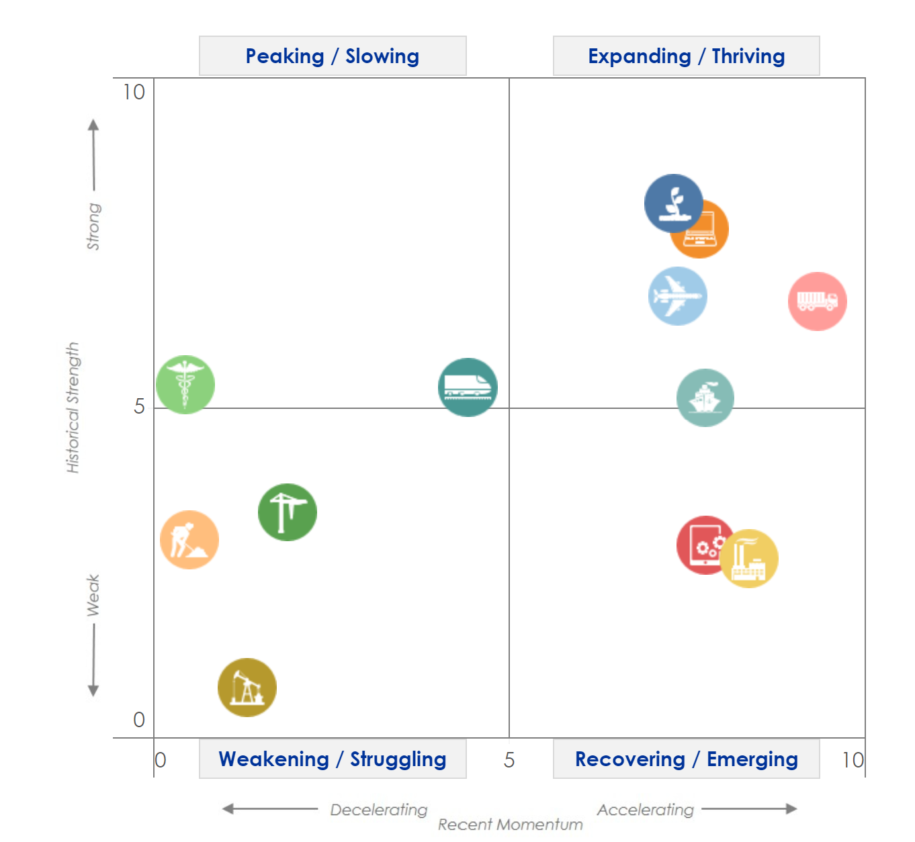
Momentum readings indicate a bifurcated market across equipment verticals, with 7 of 12 verticals accelerating and 5 verticals decelerating.
Investment
Equipment & Software Investment Momentum Monitor
Equipment Vertical Performance Matrix
Source: 2024 Equipment Leasing & Finance U.S. Economic Outlook
For more information on how to use the Momentum Monitors, see final slide.
Notes:
Equipment and Software investment expanded 5.1% in Q1 (annualized) after rising 3.0% in Q4.
Based on the latest data, investment growth in the following equipment verticals appears set to expand in the coming ~6 months:
Software
Computers
Based on the latest data, investment growth in the following equipment verticals appears set to shrink in the coming ~6 months:
Medical
Mining & Oilfield
Notes about the Equipment Vertical Performance Matrix: The matrix above summarizes the current values of each of the 12 Equipment & Software Investment Momentum Indices based on two factors: Recent Momentum (x-axis) and Historical Strength (y-axis). The matrix is comprised of four quadrants according to each vertical’s “recent momentum” and “historical strength” readings (see last slide in deck for a description of these terms):
If a vertical is located in the top-left quadrant, its momentum reading is higher than average, but positive movement has slowed (and perhaps reversed) in recent months — suggesting that investment growth may worsen over the next 2 quarters.
Verticals located in the bottom-right quadrant, however, have momentum readings that are below average, but recent movement shows promise — suggesting that investment levels may rise over the next 2 quarters. This makes them potentially attractive targets for new leasing and finance opportunities.

Slide 10
E&S investment growth is forecasted to hold steady over the course of the year, after expanding 5.1% in Q1.
Investment
Real Equipment & Software Investment Growth
Q/Q % change, SAAR
Forecast
40.1%
5.1%
-14.0%
-28.3%
Source: U.S. Bureau of Economic Analysis; Projections from Keybridge
Notes:
E&S investment accelerated in Q1, rising 5.1% (annualized) after growing 3.2% in Q4. Elevated interest rates will continue to drag on investment in 2024, and the climate for near-term investment is still modest.
The Foundation expects real equipment and software investment to grow at a 3.7% annualized pace in 2024.

Slide 11
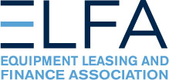
New business volume was up 4.1% year-to-date in June, currently outpacing of the rate of inflation.
Bus. Health
MLFI-25 New Business Volume (NBV)
Billions of $
Source: ELFA MLFI-25
*Note: The MLFI-25 reports economic activity from 25 companies representing a cross section of the equipment finance sector. It does not represent the total size of the equipment finance industry.
Notes:
According to ELFA’s Monthly Leasing and Finance Index, new business volume was up roughly 4% year-to-date (nominal) in June. In 2023, new business volume grew 3.2%, roughly in line with inflation.
*Note: ELFA's Monthly Leasing and Finance Index (MLFI-25) reports economic activity from 25 companies representing a cross section of the equipment finance sector. 2023 value is projected cumulative annual volume assuming May’s YTD growth rate.

Slide 12
On a nominal basis, year-over-year growth in new business volume was strongly positive in April and May but slipped in June.
Bus. Health
MLFI-25 New Business Volume (NBV)
Y/Y % change
New business volume is up 4.1% year-to-date
-4%
Source: ELFA MLFI-25
*Note: The MLFI-25 reports economic activity from 25 companies representing a cross section of the equipment finance sector. It does not represent the total size of the equipment finance industry.
Notes:
According to ELFA’s Monthly Leasing and Finance Index, new business volume was down 4% year-over-year in June but remains up 4.1% year-to-date,, laying the foundation for healthy, positive growth in 2024.
Portfolio performance was mixed in June:
Charge-offs were 0.5%, up from 0.4% the previous month and up from 0.4% in the year-earlier period.
Receivables over 30 days were 2.0%, down from 2.3% the previous month and up from 1.8% in the same period in 2023.
Meanwhile, credit approvals were unchanged at 75% for the third consecutive month, down from 77% earlier in the year.
*Note: ELFA's Monthly Leasing and Finance Index (MLFI-25) reports economic activity from 25 companies representing a cross section of the equipment finance sector.

Slide 13
Equipment finance industry confidence is up over the last year but remains muted and below the long-term average as of July.
Bus. Health
Monthly Confidence Index: Equipment Finance Industry (MCI-EFI)
50.7
Source: ELFF MCI-EFI
Notes:
In July, the MCI-EFI was 50.7, a nearly 5-point decline from a year-to-date high in March, and well below the survey’s historical average of 58. Relevant survey findings include:
Most executives (77%) expect near-term business conditions to remain the same, while 19% believe business conditions will worsen.
Only 11.5% of respondents expect demand for leases and loans to fund capex to increase, though most (73%) expect demand to remain the same.
Consistent with a healthy-but-cooling labor market, there was a slight draw-down in hiring plans. Roughly one-fourth of the executives expect to hire more employees over the next four months, a slight decrease from last month. 7.7% expect to hire fewer employees, relatively unchanged from June.
84.6% of respondents rate the current economy as “fair”. 15.1% evaluate the economy as “poor” (down from 19.2%), Zero executives evaluate the economy as “excellent.”
Note: The MCI-EFI is produced by the Foundation each month using a survey of key industry executives from banks, captives, and independent firms. It is designed to provide a qualitative assessment of both the prevailing business conditions and expectations for the future.

Slide 14
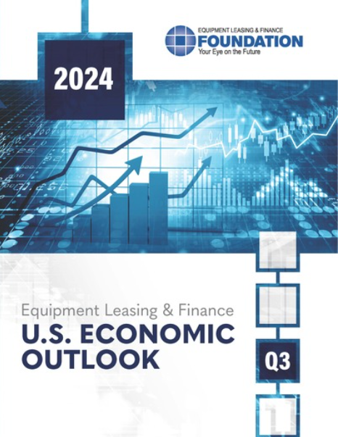
EQUIPMENT LEASING & FINANCE FOUNDATION
The latest edition of the U.S. Economic Outlook is available here at the Foundation’s website.
Reports are available to download at www.store.leasefoundation.org

Slide 15
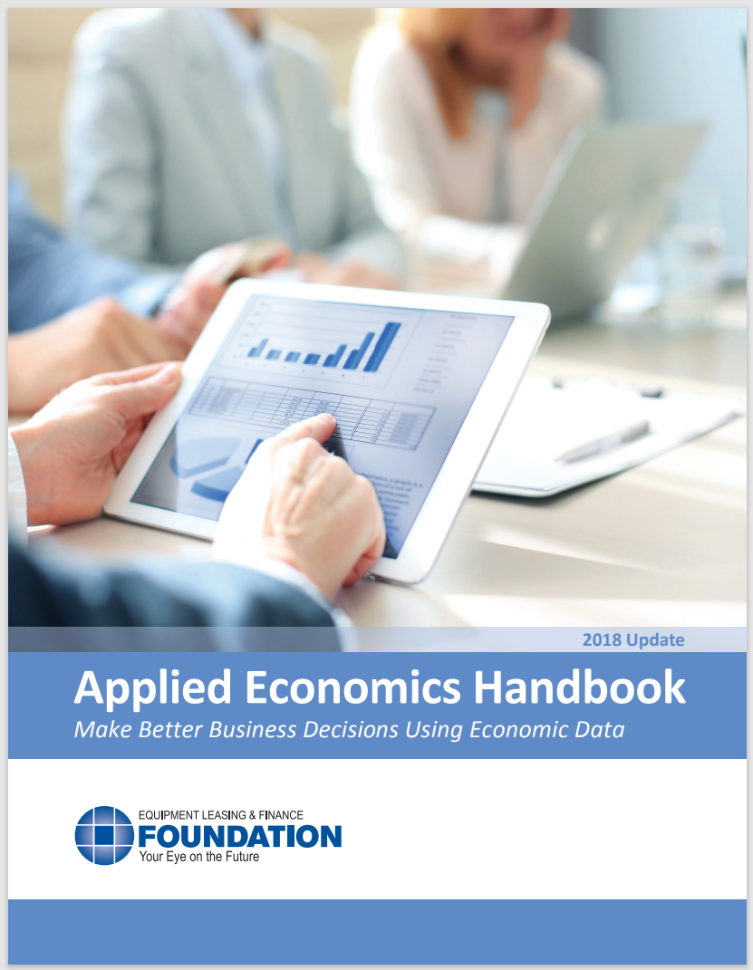
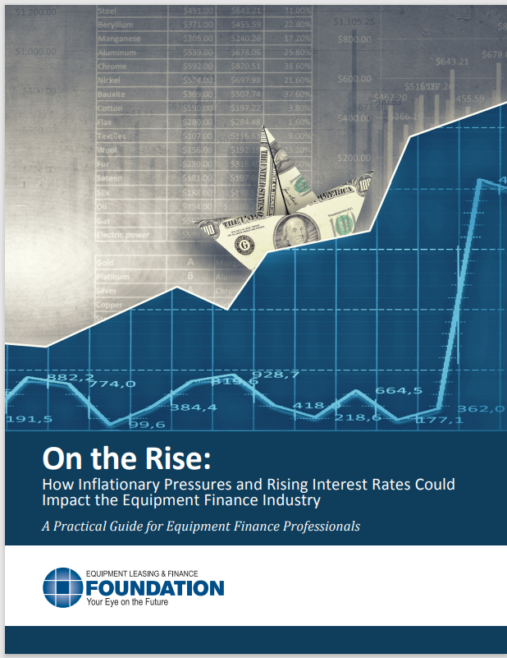
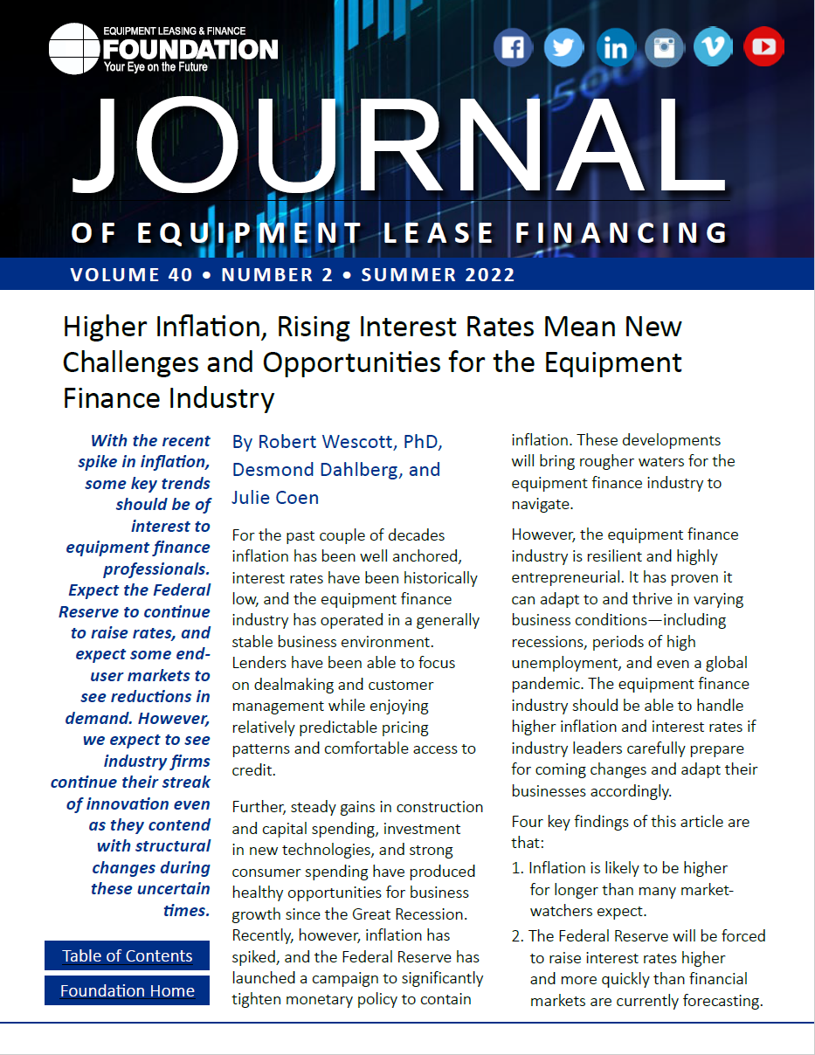
EQUIPMENT LEASING & FINANCE FOUNDATION
For more information, download the Applied Economics Handbook or research articles (2018 & 2022) analyzing the effect of inflation and rising interest rates on the equipment finance industry.

Slide 16
Notes
*U.S. Equipment & Software Investment Momentum Monitor (Slide 10)
Published monthly, the U.S. Equipment & Software Investment Momentum Monitor is a set of leading indicators for the equipment sector consisting of indices for various equipment and software investment verticals. These indices are designed to identify turning points in their respective investment cycles with a ~6-month lead time.
Each index is comprised of ~20 high-frequency indicators and is statistically optimized to signal turning points in the investment cycle without giving false readings of shifts in momentum.
The Momentum Monitor covers 12 equipment and software verticals as defined by the U.S. Department of Commerce Bureau of Economic Analysis. These verticals include aircraft, agriculture machinery, computers, construction machinery, materials handling equipment, medical equipment, mining and oilfield equipment, other industrial equipment, railroad equipment, ships and boats, software, and trucks.
“Recent Momentum" represents the degree of an indicator's recent acceleration or deceleration in the past month relative to its average movement during the previous 3 months. Ratings closer to "0" represent an indicator that is rapidly decelerating, while ratings closer to “10” represent an indicator that is rapidly accelerating.
"Historical Strength" represents the strength or weakness of an indicator in the past month relative to its typical level since 1999. Ratings closer to "0" represent an indicator that is weaker than average, while ratings closer to "10" represent an indicator that is stronger than average.

