Slide 1


EQUIPMENT LEASING & FINANCE​
A Dynamic Career Path

Slide 2
COMPANY
YOUR IMAGE HERE
Experience (What I’ve enjoyed about this industry):
Academic & Career Path: Primary Job Function:
Fun Fact About Me:
Name
Your Title

Slide 3


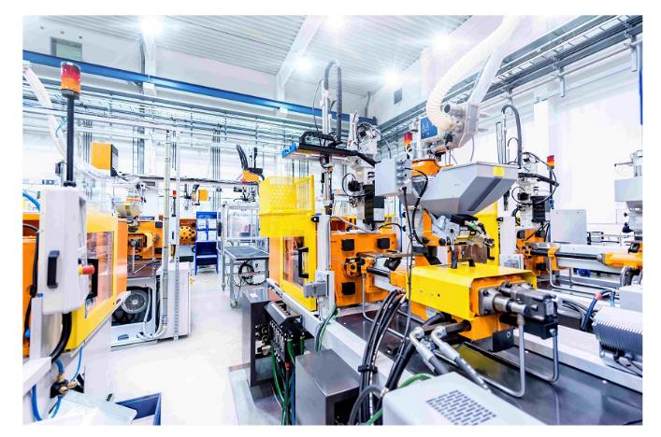
INDUSTRY FACTS
Most businesses need equipment to operate and grow.
Equipment Financings makes the equipment purchase affordable and is a key business acquisition strategy.
An estimated $1.8 trillion is invested yearly by U.S. businesses and is a key business acquisition strategy.
Over 50%, or nearly $1 trillion equipment purchased was financed through: Loans… Leases… Lines of credit.

Slide 4


The size of the U.S. equipment finance industry increased substantially in 2021, as about $1.16 trillion in equipment and software acquisitions were financed — the highest on record.

Slide 5

CERTIFIED LEASE & FINANCE PROFESSIONAL DESIGNATION
The Certified Lease & Finance Professional Foundation governs the testing, certification, and recertification of commercial equipment finance professionals with the CLFP designation.
Professionalism
Ethics
Recognition
Knowledge
Career Opportunities
Learn More: https://clfpfoundation.org

Slide 6





Notes:
ELFA Equity – DEI initiatives, Equity Forum conference
Emerging Talent Advisory Council (ETAC) – young professionals, Emergence leadership conference, podcast, networking events, career pathways
Women’s Council – Focused on women’s leadership, men welcome too! Annual Women’s Leadership Forum is one of the most popular ELFA conferences.

Slide 7
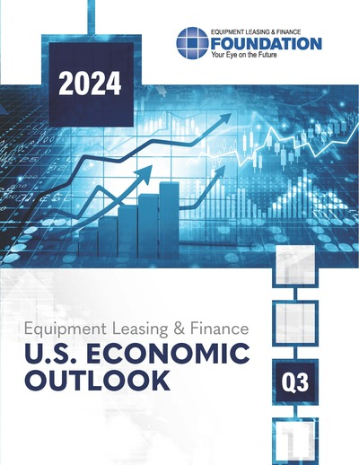
ABOUT THE FOUNDATION
The Equipment Leasing & Finance Foundation is a 501(c)3 nonprofit organization established by ELFA in 1989.
The Foundation propels the equipment finance sector—and its people—forward with its industry-specific knowledge, intelligence, and programs. Through podcasts, research studies, and Guest Lecture opportunities, we help people navigate the changes coming up to make better business and personal career decisions.
The Foundation is supported 100% by charitable donations:
  Over $800,000 raised in 2023 from corporate and individual contributions
  Donor benefits include early release of research and recognition during ELFA events
www.LeaseFoundation.org

Slide 8

WHY FINANCE EQUIPMENT?

Slide 9

EQUIPMENT FINANCING & THE BOTTOM LINE
Used in conjunction with other debt instruments, financing equipment purchases helps to better manage a company’s balance sheet.

Slide 10

TYPES OF FINANCE CONTRACTS
A loan is a finance agreement that allows a business to acquire and own equipment.
A lease allows a company to acquire and use equipment while conserving cash flow and lines of credit.

Slide 11
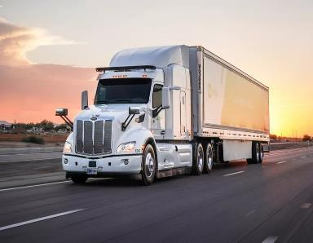
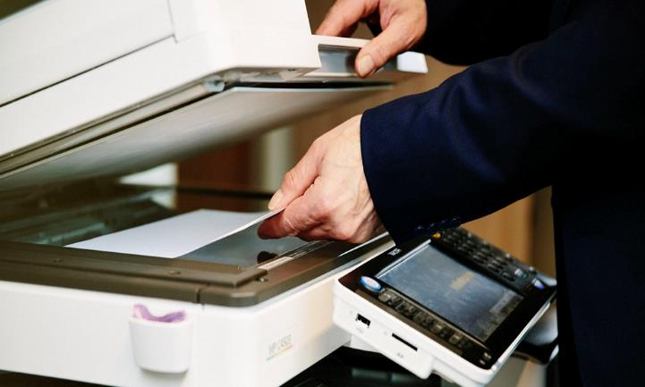

WHAT EQUIPMENT GETS FINANCED
Trucks and Transportation Equipment
Construction and Off-road Equipment
Manufacturing and Mining Machinery
Medical Technology and Equipment
Commercial and Corporate Aircraft
Rail Cars
Ships and Shipping Containers
Agricultural Equipment
Business, Retail, and Office Equipment
IT Equipment and Software
Restaurant & Hospitality Equipment
PLUS,
SO MUCH MORE!

Slide 12

WHY FINANCE EQUIPMENT?
Why it’s a smart idea to lease or finance equipment purchases:
100% Financing
Conservation of Cash
Additional Funding Channel
Hedge Against Inflation
Cash Flow Expense Planning & Business-cycle Flexibility
Regular Technology Updates
Tax Considerations
Relationship with Equipment Experts
Obsolescence Management
Product and Service Bundling
Equipment Disposal

Slide 13
BENEFITS OF EQUIPMENT FINANCE
Cash Flow
Conserve Cash for Acquisitions
Match Payments to Seasonality
Sale/Lease Back to Generate Cash
Lowest Monthly Payment with Minimal Outlay

Slide 14
BENEFITS OF EQUIPMENT FINANCE
Balance Sheet
Alternative or Additional Source to Bank Financing
Comply with Key Ratios from Lenders
Measured for Performance by ROA/ROE
Equipment
Transfer Ownership Risk to Lessor
Better Manage Obsolescence Risk
Reduce Cash Requirements During Life of Equipment

Slide 15
3 MARKET SEGMENTS

Slide 16

MARKET SEGMENTS - SMALL-TICKET FINANCING
Small-Ticket is generally transactions under $250,000.
Equipment includes but is not limited to computers, copiers, restaurant equipment, software, transportation assets, construction and medical equipment.

Slide 17
MARKET SEGMENTS- MIDDLE-MARKET FINANCING
Middle-market transactions range between $250,000 and $5,000,000.
Type of Equipment in this segment includes construction equipment, larger medical equipment, trucks/trailers, manufacturing equipment, computers and software, solar equipment, and virtually any other equipment type in this dollar range.

Slide 18

MARKET SEGMENTS - BIG-TICKET/LARGE-TICKET FINANCING
Big-Ticket/Large-Ticket is financing that usually exceeds $5,000,000.
Equipment financed includes energy projects, railroad equipment, commercial and corporate jets, vessels, other transportation equipment, and large mining, oil and gas exploration.

Slide 19
WHO ARE THE PLAYERS?
Banks
Captives
Brokers
Independents

Slide 20
Banks offer loan and lease finance products to provide customers with a full range of financial services. Examples:
Banks
Bank of America Global Leasing
BMO
DLL
PNC Equipment Finance
First Citizens Bank
Huntington Asset Finance
Midland Equipment Finance
U.S. Bank Equipment Finance
Pacific Western Bank
Truist Equipment Finance Corp.
Fifth Third Bank
Wintrust Asset Finance
Wells Fargo Equipment Finance
Western Equipment Finance

Slide 21
Captives are companies set up by a manufacturer or equipment dealer to finance the sale or lease of its own products to end-users. Examples include:
Caterpillar Financial Services Corp.
John Deere Financial
Volvo Financial Services
CNH Industrial Capital
HP Inc.
IBM Global Financing
Cisco Systems Capital Corporation
Xerox
Dell Financial Services
Toyota Industries Commercial Finance, Inc.
Captives

Slide 22
An Independent Leasing company is not affiliated with any company...they may borrow lines of credit from lenders and/or self-fund transactions. Independent Leasing companies vary in products and services. They are typically generalists specialized by ticket size, equipment type, or other criteria. Examples:
Madison Capital
Amur Equipment Finance
Great America Financial Services
ENGS Commercial Finance Co.
Insight Investments, LLC
QuickFi by Innovation Finance USA LLC
Crossroads Equipment Lease & Finance LLC
Stonebriar Commercial Finance
Independents

Slide 23
Brokers establish a relationship with the potential client and assess their equipment financing needs to help determine the best product and structure to meet these needs.
Brokers
The Broker then packages and presents the deal to the best funding partner.
Brokers earn fees for services from either the client or the funding partner.

Slide 24
EQUIPMENT FINANCE SERVICE PROVIDER
Software Executive/Entrepreneur
Includes CRM, ERP, originations, pricing, credit analysis, and BI software companies, many founded to serve the lending and leasing industry.
Capital Agent
Raises capital and funds leasing and lending companies.
Consultant
Consulting organizations have a presence in the secured lending and leasing finance industry.
Legal
Law firms specialize in laws and regulations around l
Service
Providers
Solifi
Equifax
LTi Technology Solutions
Great American Insurance Group
Moritt Hock & Hamroff LLP

Slide 25


SYNDICATIONS – CAPITAL MARKETS
Syndications: Participation of financial institutions in a sale and/or assignment of all or part of an underlying lease or loan transaction.
Larger equipment financing companies maintain a buy and sell desk. Large equipment leases or loans may require a syndication strategy to meet the customer’s needs and the bank’s credit requirements.
Example: ABC Bank Lessor originated an $80 million lease for 1,800 railcars. They approve a “hold position” of $40 million for this client; syndicate $40 million to third party investors.
Customer Benefits: Deal with a single lessor, negotiate 1 set of docs; and 1 servicer.
Benefits to Syndicator: Manage credit exposure, earn fee income, retain client relationship.
Allocation: Investor is allocated specific assets tied to the same lease. If financing is for one large asset that can’t be divided (a large aircraft), a Participation Agreement is created.
.

Slide 26


CAREER PATHS IN
EQUIPMENT FINANCE
Learn more: https://www.elfaonline.org/career-pathways
Notes:
There are many different careers paths within the field of equipment finance. It’s not just for finance and accounting students!

Slide 27
CAREER AREAS IN EQUIPMENT FINANCE
Accounting
Tax Accounting
Finance
Audit & Compliance
Asset Management
Contract Law
Credit
Office/Administrative Mgt.
Credit – Underwriting
Risk Management
Portfolio Management
Capital Agent
Dealer/ Finance Manager
Sales & Sales Management
Marketing/Advertising - Digital, Social Media, Print
Event planning
Technology/Software
Economists
Researchers Market Conditions
Insurance
Project Manager
Operations
Supply Chain
Syndication
Logistics
Residual Value Specialists
Collections
Communication/PR/Journalist
Relationship Manager
International lending
Merger and Acquisitions
Consulting

Slide 28
CAREERS IN EQUIPMENT FINANCE – A Closer Look
Executive/Entrepreneur
Corporate leaders and entrepreneurs who set the vision and lead its execution for leasing/lending organizations in banks, manufacturers, or independent entities.
Relationship Manager
Sell lease and loan financing solutions to meet customer equipment financing needs. RMs coordinate the credit approval and documentation process to meet client expectations. Compensation is typically tied to results with commissions paid on funded volume.
Economics/Capital Markets
Provide value-added pricing and economic analysis support by keeping up on developments in the accounting, tax, and regulatory environment, as well as following market conditions.
Credit
Includes underwriters who understand the risk dynamics in the equipment leasing and finance industry. Credit employees conduct deal analysis yet wear a business hat. Typically have a macro view of the economy.
Asset Management
Deep knowledge of equipment assets and customer requirements. Brokerage capability to place equipment into secondary markets.

Slide 29
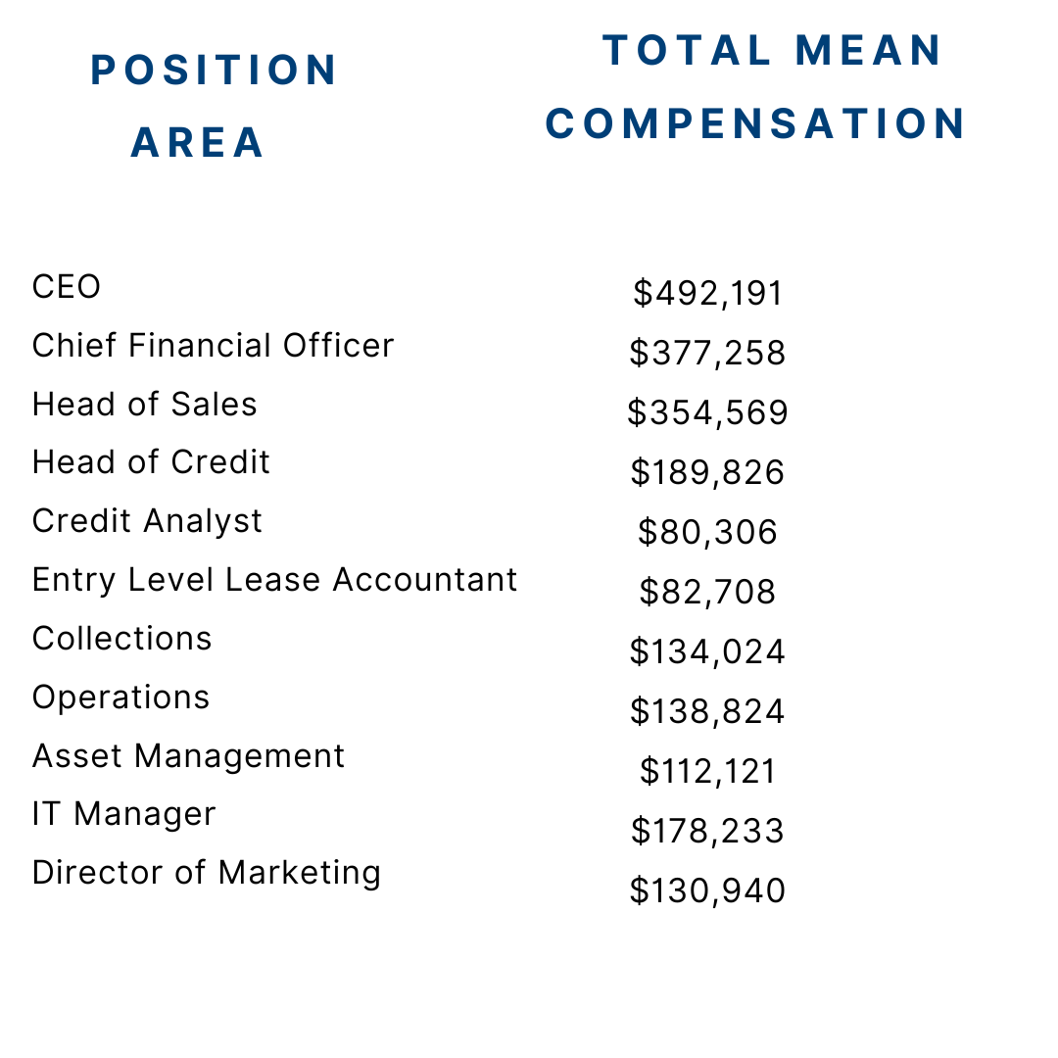

MEAN COMPENSATION FOR SMALL AND MEDIUM SIZE BUSINESS
Source: ELFA Small & Medium Enterprise Compensation Survey

Slide 30
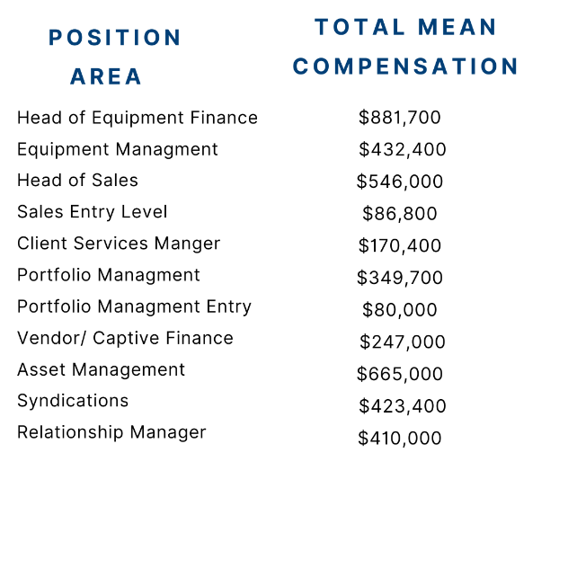
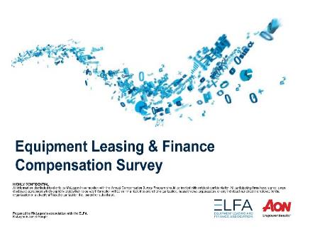
MEAN COMPENSATION FOR LARGE COMPANIES
Source: 2022 Equipment Leasing & Finance Compensation Survey

Slide 31

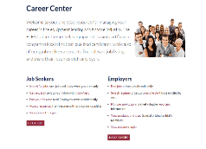
LOOKING FOR AN INTERNSHIP OR JOB ?
The Foundation Internship Resource Page provides a platform for students to search some of the top companies providing internship opportunities in the field of equipment finance.
https://www.leasefoundation.org/academic-programs/internship-resources-page
The ELFA’s digital Career Center is a one-stop resource for finding positions in the equipment finance industry.
https://www.elfaonline.org/people-power/career-center

Slide 32


SCHOLARSHIP
OPPORTUNITIES
SCHOLARSHIP PROGRAM
2025 CYCLE OPENS IN FEBRUARY
Up to five scholarships of $5,000 each will be awarded to students focusing on business, economics, finance, or a related discipline.
Scan the QR code for more information.

Slide 33
THANK YOU!
Questions?

