Slide 1
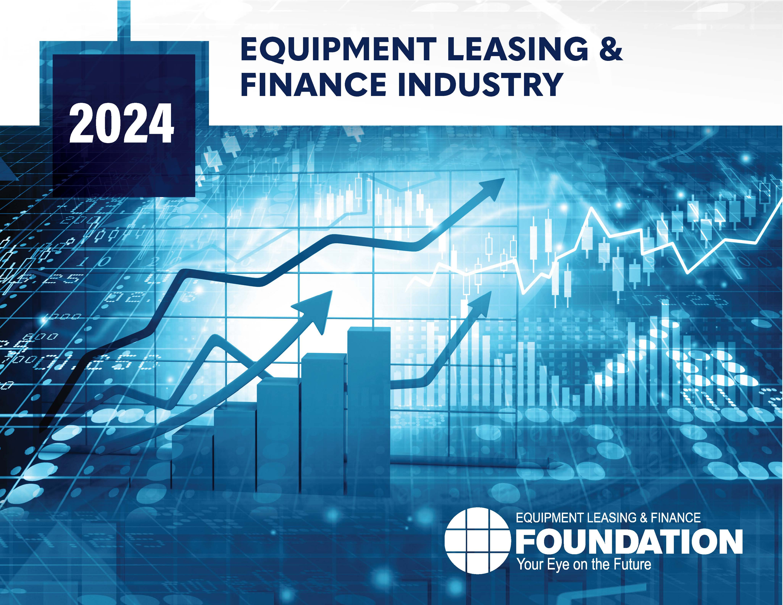


Snapshot of the Equipment Leasing and Finance Industry and U.S. Economy
October 2024
Prepared For:
Equipment Leasing & Finance Foundation
Prepared By:
Keybridge LLC

Slide 2
Data: Table of Contents
1. Overall Economy
p. 3
2. Investment
p. 9
3. Business Health
p. 12

Slide 3

The U.S. economy expanded at 3.0% (SAAR) in the second quarter of 2024, an increase from 1.6% growth in Q1 2024.
Economy
Real GDP Growth
Annualized % Change from Prior Quarter
Forecast
30-Year Quarterly Average = 2.6%
35.3%
3.0%
-29.9%
Source: U.S. Bureau of Economic Analysis, Keybridge LLC
Notes:
The U.S. economy continues to expand at a solid clip. Growth in the second quarter was stronger than expected, and investment in equipment and software was particularly strong.
Consumer spending was, yet again, the largest driver of economic growth in Q2, and recent BEA data revisions suggest that both personal income and the personal savings rate are higher than originally estimated, easing fears of a consumer retrenchment later this year or next year.
Overall, a recession in 2024 remains unlikely. Layoffs remain low by historical standards and real wage growth is healthy, inflation is modestly elevated but largely contained, and the prospect for additional rate cuts later this year and next year should provide a boost to hiring and investment. Whoever prevails in the Presidential election will inherent an economy that is poised for growth in 2025.

Slide 4
Q2 growth was primarily driven by consumer spending, supported by a boost in inventories, business investment, and government spending.
Economy
Tailwinds & Headwinds
Contributions to GDP growth by sector
TAILWINDS
HEADWINDS
[+4.00]
[-1.01]
Residential Investment (-0.11)
Government Spending
+0.52
-0.90
Net Exports
Business Investment
+0.53
+1.05
Change in Private Inventories
NET CHANGE
IN GDP
+3.0
Consumer Spending
+1.90
Source: U.S. Bureau of Economic Analysis, Keybridge LLC
Notes:
Economists often use a simple formula to describe the U.S. economy: “C + I + G + NX” (consumption + investment + government spending + net exports). With this in mind, the primary drivers of Q2’s expansion were consumer spending, private inventories, business investment, and government spending. Net exports and residential investment contributed negatively to GDP growth.
Consumer spending expanded 2.8% (annualized) in Q2. Spending on services cooled slightly to 2.7% in Q2, down from 3.4% in Q1. The gap was more than offset by a 3.0% annualized increase in goods spending, up from -1.2% in Q1. Durable goods drove the improvement.
Government spending picked back up in Q2 (3.1% annualized), largely due to strong growth in defense spending. State and local spending slowed to 2.3% annualized, the lowest reading in two years.
Equipment investment (separate from software investment) rose a strong 9.8% (annualized) after three consecutive quarters of sluggishness. Investment in aircraft was primarily responsible for the improvement, along with information processing equipment. Industrial equipment contracted modestly. Intellectual property products (i.e., software) softened to 0.7% in Q2, down from 7.5% in Q1.

Slide 5

Special Topic: The Economic Impact of Tariffs
While tariffs have their place in U.S. trade policy, broad application would damage growth.
Historical Context
After joining the General Agreement on Tariffs and Trade (GATT) post-World War II, the use of tariffs and other protectionist policies in the United States declined.
The GATT led to era of globalization and a significant reduction in tariff rates.
Despite near-universal agreement among economists that protectionist policies harm the U.S. economy, they are often touted by presidential candidates.
Recent Tariff Policies
The Trump administration introduced the broadest set of tariffs since the end of WWII in 2018-19, leading to a trade war with China.
The Biden administration maintained most of these tariffs to address anti-competitive practices from China, and also introduced new tariffs on steel, aluminum, medical equipment, EVs, batteries, and solar cells.
Tariffs on imported goods can help protect vital domestic industries, raise revenue, and influence foreign policy — but also lead to higher prices.
Economic Impact & Effectiveness of Tariffs
  The economic impact of a tariff is complex and difficult to predict. However, in most cases, U.S. consumers end up shouldering nearly all of the cost.
  Recent tariffs have failed to achieve their central purpose. The trade deficit has widened significantly, and the Tax Foundation estimates a net job loss of 142,000 and price increases equivalent to a $200-300/year tax on U.S. households.
  Moreover, the risk of international retaliation is high. If a 20% across-the-board tariff were implemented, the U.S. would experience retaliatory tariffs, reducing global trade and potentially triggering a full-blown trade war.
Source: 2024 Q4 Equipment Leasing & Finance U.S. Economic Outlook
Notes:
The Economic Impact of Tariffs
Historical Context –
The GATT was one prong of the three-pronged Bretton Woods system that ignited an era of globalization.
Recent Tariff Policies & Political Motivations–
Effect of the Chinese trade war caused by Trump-era tariffs:
U.S. tariffs on Chinese exports increased to 19.3% (up from less than 5% prior to 2018)
Retaliatory Chinese tariffs on U.S. exports raised to 21.1%
The Biden Administration, in addition to keeping most of the Trump-era tariffs in place, introduced new tariffs on steel, aluminum, medical equipment, EVs, batteries, and solar cells in 2024.
Trump: Chinese goods accounted for 85% of total tariff revenue received in the United States
Biden: Chinese goods accounted for 94% of total tariff revenue received in the United States
Economic Impact and Effectiveness of Tariffs –
In some cases, exporters may be able to raise their price to offset the cost of the tariff. In other cases, tariffs may cause a foreign exporter to no longer be able to compete. In most cases, consumers ultimately end up paying more.
Tariffs may have populist appeal, and when applied selectively they can be beneficial. But they are not a panacea, nor a substitute for sound economic policy

Slide 6

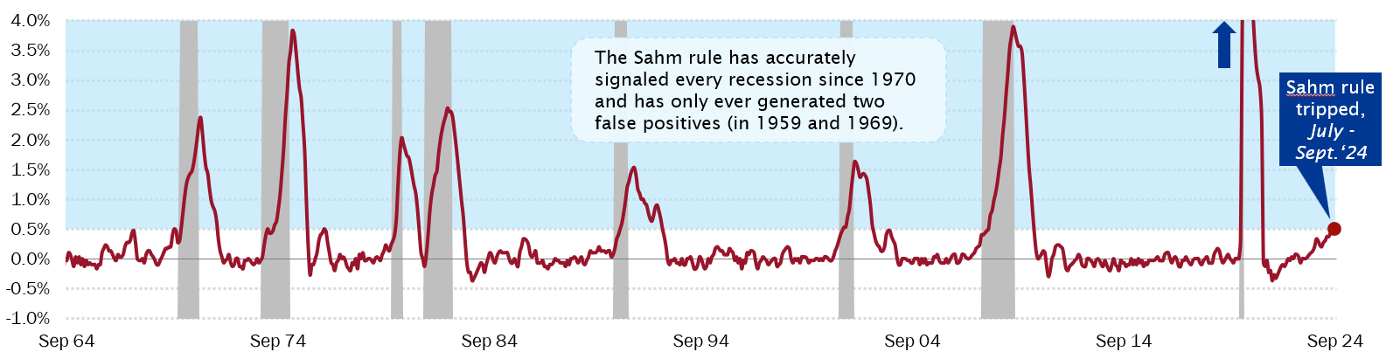
Special Topic: A Softening Labor Market Sparks Economic Anxiety
A period of normalization or a period of slowing?
Labor Market Outlook
After several months of soft labor market data, the September employment report was surprisingly strong: 254,000 new jobs were added, nominal wages expanded at 4.0%, and the unemployment rate fell to 4.1%.
Still, there is little question that the labor market is no longer the engine of growth it was in the post-2020 expansion. There are several indicators that warn of further cooling, including the Sahm Rule (see chart below), a falling new hire rate, and declining temporary workers.
Additional rate cuts should help to stimulate growth in 2025, but the effects of rate changes may take up to two years to manifest.
While there are reasons to be guarded about the prospects for near-term job growth, the labor market remains on track and Keybridge expects it to continue to expand sustainably next year.
The Sahm Rule is tripped when the three-month moving average of the unemployment rate increases by .05 percentage points or more over the course of a year (indicated by the blue shading below)
Source: Real-Time Sahm Rule Recession Indicator, retrieved from FRED;
2024 Q4 Equipment Leasing & Finance U.S. Economic Outlook
Notes:
After averaging more than 250,000 jobs per month from January 2023 through March 2024, job growth slowed to less than 150,000 from April – August, with unemployment rising 0.4 percentage points during this period.
Other labor market indicators point to a slowdown in jobs growth:
The rate of new hires has fallen consistently since 2021 and now sits at 3.3%, well below its pre-pandemic level (see top chart). The hiring rate is closely associated with unemployment: when the rate falls, unemployment typically rises.
The number of temporary workers has declined sharply over the last two years, partly due to a sharp increased in demand for temporary help fueled by post-pandemic recovery.
The “Sahm Rule”
The signal exceeded its revolutionary threshold in July, but Sahm believes it is likely overstating labor market weakness due to lingering pandemic-era effects and increased immigration.
Looking to 2025, additional rate cuts should help to stimulate growth, though it is worth noting that economists at the Kansas City Fed estimate the effect of rate changes on employment could take up to two years to manifest. Policy uncertainty should fall once the results of the election are known, which may also trigger renewed hiring. Overall, while there are reasons to be guarded about the prospects for near-term job growth, we believe the labor market remains on track and will continue to expand sustainably next year.

Slide 7
Projections for Key Economic Indicators
Indicator | 2022 | 2023 | 2024 Quarterly Estimates |  |  |  | 2024e
 |  |  | Q1 | Q2 | Q3e | Q4e
Real GDP (SAAR %) | 2.5% | 2.9% | 1.6% | 3.0% | 2.8% | 1.8% | 2.7%
Real Investment in Equipment & Software (SAAR %) | 7.8% | 4.8% | 4.0% | 7.0% | 3.7% | 2.6% | 4.4%
Inflation (year-on-year %) | 8.0% | 4.1% | 3.2% | 3.2% | 2.6% | 2.6% | 2.6% (end of year)
Federal Funds Target Rate (upper bound, end of period) | 4.50% | 5.50% | 5.50% | 5.50% | 5.00% | 4.75% | 4.75% (end of year)
Total Payroll Growth (thousands) | 4,528 | 3,013 | 802 | 442 | 557 | 425 | 2,226
Source: 2024 Q4 Equipment Leasing & Finance U.S. Economic Outlook
Notes:
GDP: We expect real GDP to grow by 2.7% in 2024, a relatively healthy year of economic growth.
Investment: We expect E&S investment to expand at a moderate 4.8% annualized rate —softer than 2023, but sufficient to drive growth in the equipment finance industry.
Inflation: We expect CPI headline inflation to remain at 2.6% through the rest of the year.
Interest Rates: We expect one more rate cut of 25 basis points this year, either in November or December.
Job Growth: Over the summer, job growth and rising unemployment were softer-than-anticipated. Still, layoffs remain low by historical standards and real wage growth is healthy. Overall, while there are reasons to be guarded about the prospects for near-term job growth, we expect the hiring rate to remain health through the end of the year.

Slide 8
Nonresidential fixed investment has expanded for the last 11 quarters, growing 3.9% (SAAR) in Q2 2024.
Investment
Business Investment
Real Nonresidential Fixed Investment, % Change from Prior Quarter
3.9%
-29.4%
-28.5%
Source: U.S. Bureau of Economic Analysis
Notes:
Business investment grew in Q2, rising 3.9% (annualized). Growth contracted slightly from 4.5% in the previous quarter.
Business investment (also known as nonresidential fixed investment) consists of three elements: equipment, software and R&D, and non-residential structures (e.g., commercial buildings, oil platforms).
Equipment: +9.8% (annualized) (down from 0.3% in Q1)
Non-residential structures: +0.2% (annualized) (up from 6.3% in Q1)
Software and R&D: +0.7% (annualized) (down from +7.5% in Q1)

Slide 9
Momentum readings indicate a bifurcated market across equipment verticals, with 6 of 12 verticals accelerating and 6 verticals decelerating.
Investment
Equipment & Software Investment Momentum Monitor
Equipment Vertical Performance Matrix
Peaking / Slowing
Expanding / Thriving
Historical Strength
0
Weak
Strong
10
Weakening / Struggling
Recovering / Emerging
0
Decelerating
Accelerating
10
Recent Momentum
Source: 2024 Q4 Equipment Leasing & Finance U.S. Economic Outlook
For more information on how to use the Momentum Monitors, see final slide.
Notes:
Equipment and Software investment expanded 7.0% in Q2 (annualized) after growing by 4.0% in Q1.
Based on the latest data, investment growth in the following equipment verticals appears set to expand in the coming ~6 months:
Ships & Boats
Aircraft
Based on the latest data, investment growth in the following equipment verticals appears set to shrink in the coming ~6 months:
Construction Machinery
Medical Equipment
Railroad Equipment
Trucks
Notes about the Equipment Vertical Performance Matrix: The matrix above summarizes the current values of each of the 12 Equipment & Software Investment Momentum Indices based on two factors: Recent Momentum (x-axis) and Historical Strength (y-axis). The matrix is comprised of four quadrants according to each vertical’s “recent momentum” and “historical strength” readings (see last slide in deck for a description of these terms):
If a vertical is located in the top-left quadrant, its momentum reading is higher than average, but positive movement has slowed (and perhaps reversed) in recent months — suggesting that investment growth may worsen over the next 2 quarters.
Verticals located in the bottom-right quadrant, however, have momentum readings that are below average, but recent movement shows promise — suggesting that investment levels may rise over the next 2 quarters. This makes them potentially attractive targets for new leasing and finance opportunities.

Slide 10
After expanding 7.0% (annualized) in Q2, E&S investment growth is expected to moderate in the latter half of 2024.
Investment
Real Equipment & Software Investment Growth
Q/Q % change, SAAR
Forecast
40.1%
7.0%
-14.0%
-28.3%
Source: U.S. Bureau of Economic Analysis; Projections from Keybridge
Notes:
After three consecutive weak quarters, E&S investment accelerated in Q2, expanding at a rate of 7.0% (annualized) after growing 4.0% in Q1. Aircraft investment was primarily responsible for the improvement, along with information processing equipment. Industrial equipment contracted modestly.
The Foundation expects real equipment and software investment to moderate in the latter half of 2024 and is expected to grow at a 4.4% annualized pace across 2024.

Slide 11
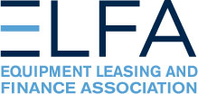
New business volume was up 3.4% year-to-date in August, currently outpacing of the rate of inflation.
Bus. Health
MLFI-25 New Business Volume (NBV)
Billions of $
Source: ELFA MLFI-25
*Note: The MLFI-25 reports economic activity from 25 companies representing a cross section of the equipment finance sector. It does not represent the total size of the equipment finance industry.
Notes:
According to ELFA’s Monthly Leasing and Finance Index, new business volume was $9.2 billion in August, down 10% from August 2023.
Note: The Equipment Leasing and Finance Association’s (ELFA) Monthly Leasing and Finance Index (MLFI-25), a survey of economic activity from 25 companies representing a cross section of the $1 trillion equipment finance sector

Slide 12
Nominal new business volume growth declined nearly 10% year-over-year in August but is still up 3.5% year-to-date.
Bus. Health
MLFI-25 New Business Volume (NBV)
Y/Y % change
Despite contracting in August, new business volume is up 3.5% year-to-date
-9.8%
Source: ELFA MLFI-25
*Note: The MLFI-25 reports economic activity from 25 companies representing a cross section of the equipment finance sector. It does not represent the total size of the equipment finance industry.
Notes:
According to ELFA’s Monthly Leasing and Finance Index, new business volume (NBV) totaled $9.2 billion in August, down 10% on a Y/Y basis. Year-to-date, NBV was up 3.5% compared to August 2023.
Portfolio performance improved slightly but remains slightly weaker compared to a year ago:
Charge-offs were 0.4%, down from 0.5% the previous month and up from 0.3% year over year.
Receivables over 30 days were 2.2%, down from 2.5% the previous month and down from 2.3% in the same period in 2023.
Meanwhile, credit approvals totaled 76%, unchanged from July.
*Note: ELFA's Monthly Leasing and Finance Index (MLFI-25) reports economic activity from 25 companies representing a cross section of the equipment finance sector.

Slide 13
Equipment finance industry confidence is growing, with recent index readings holding steady at its highest level since 2022.
Bus. Health
Monthly Confidence Index: Equipment Finance Industry (MCI-EFI)
61.8
Source: ELFF MCI-EFI
Notes:
In October, the MCI-EFI held steady at 61.8, the third month of readings above the historical average and the second highest reading since early 2022. Relevant survey findings include:
Almost all respondents (93%) rate the economy as “fair,” down from 96% last month.
38% of executives expect near-term business conditions to improve (down from 40%), while 52% believe business conditions will remain the same.
More respondents expect demand for leases and loans to fund capex to increase (45%, up from 44%), while 41% half expect demand to remain the same, down from 52%.
38% of respondents believe that U.S. economic conditions will improve over the next six months, down from 24% in September. A little over half of respondents (52%, down from 76% last month) believe the economic will “stay the same”, while 10% believe economic conditions will worsen, up from 0% the previous month.
Note: The MCI-EFI is produced by the Foundation each month using a survey of key industry executives from banks, captives, and independent firms. It is designed to provide a qualitative assessment of both the prevailing business conditions and expectations for the future.

Slide 14
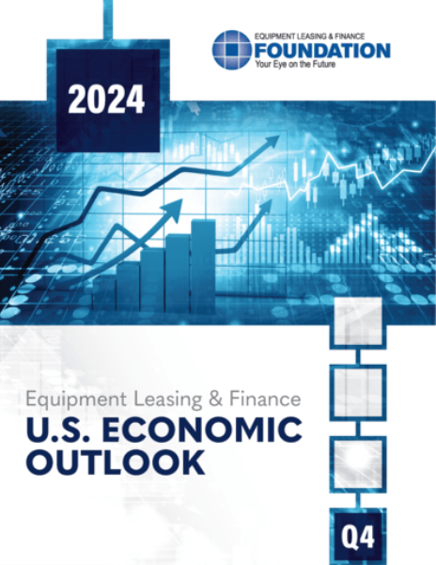
EQUIPMENT LEASING & FINANCE FOUNDATION
The latest edition of the Keybridge / Foundation U.S. Economic Outlook is available here at the Foundation’s website.
Reports are available to download at www.store.leasefoundation.org

Slide 15
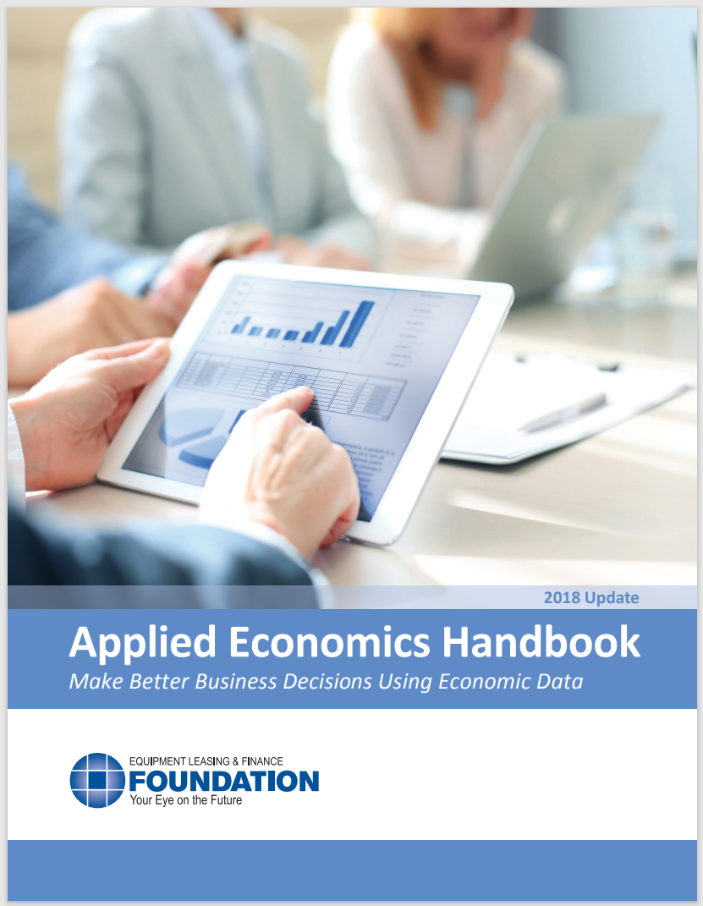
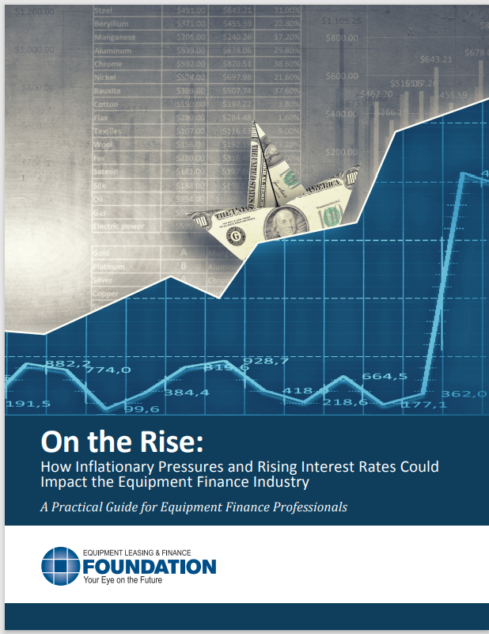
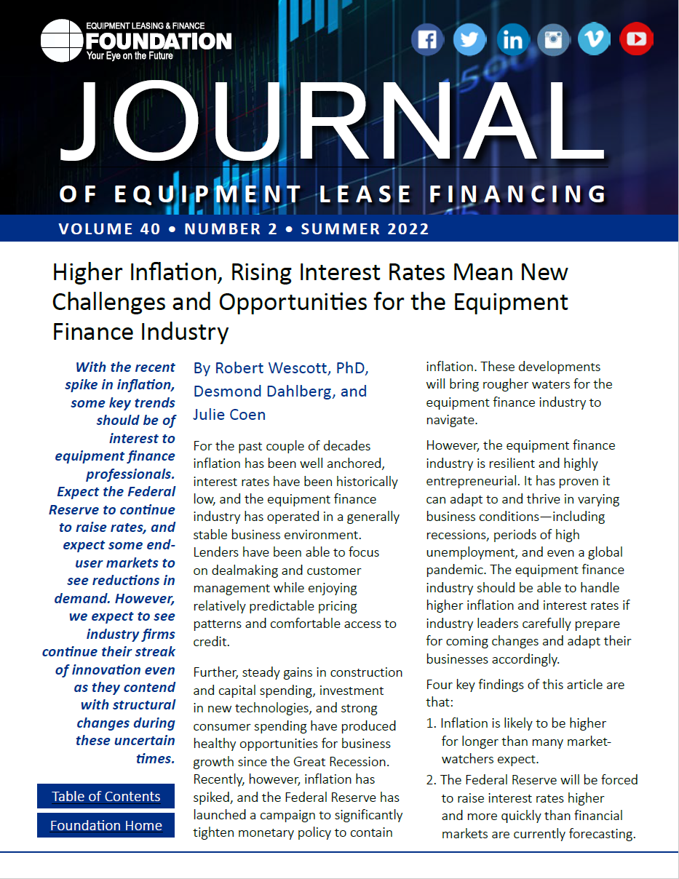
EQUIPMENT LEASING & FINANCE FOUNDATION
For more information, download the Applied Economics Handbook or research articles (2018 & 2022) analyzing the effect of inflation and rising interest rates on the equipment finance industry.

Slide 16
Notes
*U.S. Equipment & Software Investment Momentum Monitor (Slide 10)
Published monthly, the U.S. Equipment & Software Investment Momentum Monitor is a set of leading indicators for the equipment sector consisting of indices for various equipment and software investment verticals. These indices are designed to identify turning points in their respective investment cycles with a ~6-month lead time.
Each index is comprised of ~20 high-frequency indicators and is statistically optimized to signal turning points in the investment cycle without giving false readings of shifts in momentum.
The Momentum Monitor covers 12 equipment and software verticals as defined by the U.S. Department of Commerce Bureau of Economic Analysis. These verticals include aircraft, agriculture machinery, computers, construction machinery, materials handling equipment, medical equipment, mining and oilfield equipment, other industrial equipment, railroad equipment, ships and boats, software, and trucks.
“Recent Momentum" represents the degree of an indicator's recent acceleration or deceleration in the past month relative to its average movement during the previous 3 months. Ratings closer to "0" represent an indicator that is rapidly decelerating, while ratings closer to “10” represent an indicator that is rapidly accelerating.
"Historical Strength" represents the strength or weakness of an indicator in the past month relative to its typical level since 1999. Ratings closer to "0" represent an indicator that is weaker than average, while ratings closer to "10" represent an indicator that is stronger than average.

