Slide 1


DISCOVER
EQUIPMENT FINANCE!

Slide 2

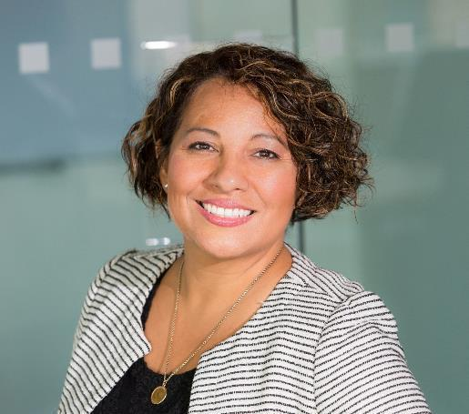
ADD YOUR
COMPANY LOGO HERE
JANE DOE
REPLACE
HEADSHOT
TITLE/COMPANY
EDUCATION
YEARS OF EXPERENCE

Slide 3

Why Finance
Equipment?

Slide 4

EQUIPMENT FINANCE
Equipment financing is a loan or lease used specifically to purchase business equipment.
Over 50% of equipment purchased is financed through Loans, Leases, and Lines of Credit.

Slide 5

EQUIPMENT FINANCING…
HELPS
Manage Cash Flow
Access New Technology
Tax Benefits
Hedge Against Inflation
Preserve Capital

Slide 6

Types of Contracts
A loan is a finance agreement that allows a business to acquire and own equipment.
A lease allows a company to acquire and use equipment while conserving cash flow and lines of credit.

Slide 7

BENEFITS OF EQUIPMENT FINANCE
Cash Flow
Conserve Cash for Acquisitions
Match Payments to Seasonality
Sale/Lease Back to Generate Cash
Lowest Monthly Payment with Minimal Outlay
Equipment
Transfer Ownership Risk to Lessor
Better Manage Obsolescence Risk
Reduce Cash Requirements During Life of Equipment

Slide 8

BENEFITS OF EQUIPMENT FINANCE
Balance Sheet
Alternative or Additional Source to Bank Financing
Comply with Key Ratios from Lenders
Measured for Performance by ROA/ROE
Equipment
Transfer Ownership Risk to Lessor
Better Manage Obsolescence Risk
Reduce Cash Requirements During Life of Equipment

Slide 9

WHAT EQUIPMENT
GETS FINANCED
Transportation Equipment
Construction Equipment
Manufacturing and Mining Machinery
Medical Equipment
Aircrafts
Rail Cars
Ships & Shipping Containers
Agricultural Equipment
Office Equipment
Technology Equipment
Restaurant & Hospitality Equipment
AND MUCH MORE…

Slide 10
Equipment Finance Industry Size 2016–2027
Cash Flow
Conserve Cash for Acquisitions
Match Payments to Seasonality
Sale/Lease Back to Generate Cash
Lowest Monthly Payment with Minimal Outlay
Equipment
Transfer Ownership Risk to Lessor
Better Manage Obsolescence Risk
Reduce Cash Requirements During Life of Equipment
Sources: BEA; Foundation end-user surveys; Keybridge LLC. Note: The term “equipment finance” is used to denote public and private equipment and software acquired via lease, secured loan, or line of credit. Non-financed equipment is acquired through cash, credit card (paid in full), or another method.

Slide 11
MARKET
SEGMENTS

Slide 12

MARKET SEGMENTS
SMALL-TICKET FINANCING
Small-Ticket transactions
Are generally under $250,000
Equipment includes but is not limited to computers, copiers, restaurant equipment, software, transportation assets, construction and medical equipment.

Slide 13
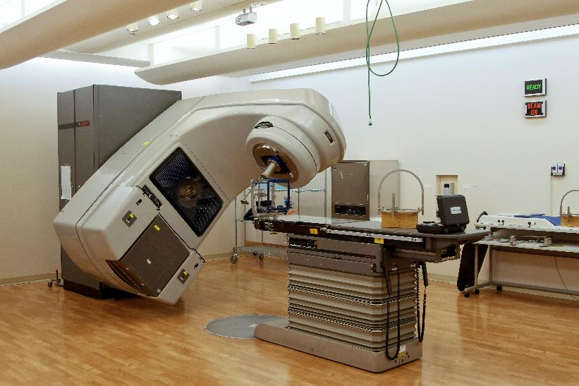
MARKET SEGMENTS
MIDDLE-MARKET FINANCING
Middle-Market transactions
range between $250,000 and
$5,000,000
Type of Equipment in this segment includes construction equipment, larger medical equipment, trucks/trailers, manufacturing equipment, computers and software, solar equipment, and virtually any other equipment type in this dollar range.

Slide 14

MARKET SEGMENTS
BIG-TICKET/LARGE-TICKET FINANCING
Big-Ticket/Large-Ticket is
financing that usually exceeds
$5,000,000
Equipment financed includes energy projects, railroad equipment, commercial and corporate jets, vessels, other transportation equipment, and large mining, oil and gas exploration.

Slide 15
Equipment Financing
PLAYERS

Slide 16

EQUIPMENT
FINANCING
PLAYERS
Banks
Captives
Independents
Brokers
Service
Providers

Slide 17









Banks
Banks offer loan and lease finance products to provide customers with a full range of financial services.

Slide 18





Captives
Captives are companies set up
by a manufacturer or equipment dealer to finance the sale or lease of its own products to end-users.

Slide 19
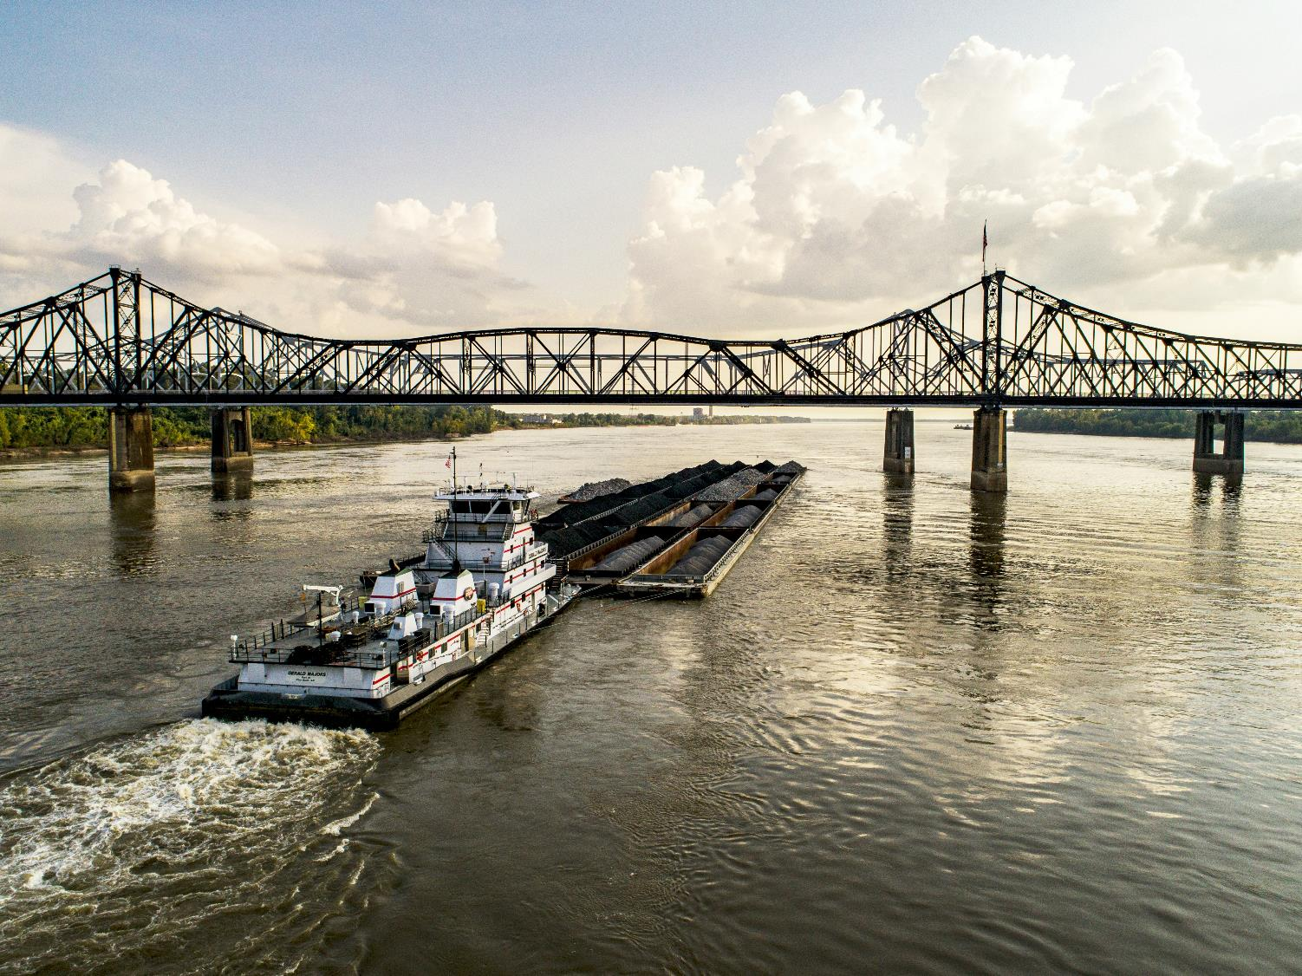




An Independent Leasing company is not affiliated with any company...they may borrow lines of credit from lenders and/or self-fund transactions.
Independent Leasing companies vary in products and services. They are typically generalists specialized by ticket size, equipment type, or other criteria.
Independents

Slide 20

Brokers
Brokers establish a relationship with the potential client and assess their equipment financing needs to help determine the best product and structure to meet these needs.

Slide 21






SERVICE PROVIDERS
Capital Agent
Raises capital and funds leasing and lending companies.
Consultant
Consulting organizations have a presence in the secured lending and leasing finance industry.
Software Executive/Entrepreneur
Includes CRM, ERP, originations, pricing, credit analysis, and BI software companies, many founded to serve the lending and leasing industry.
Legal
Law firms specialize in
laws and regulations around
equipment leasing

Slide 22

CAREER AREAS IN EQUIPMENT FINANCE
Accounting
Tax Accounting
Finance
Audit & Compliance
Asset Management
Contract Law
Credit
Office/Administrative Mgt.
Credit – Underwriting
Risk Management
Portfolio Management
Capital Agent
Dealer/ Finance Manager
Sales & Sales Management
Marketing/Advertising
Event planning
Technology/Software
Economists
Researchers Market Conditions
Insurance
Project Manager
Operations
Supply Chain
Syndication
Logistics
Residual Value Specialists
Collections
Communication
Relationship Manager
International lending
Merger and Acquisitions
Consulting

Slide 23

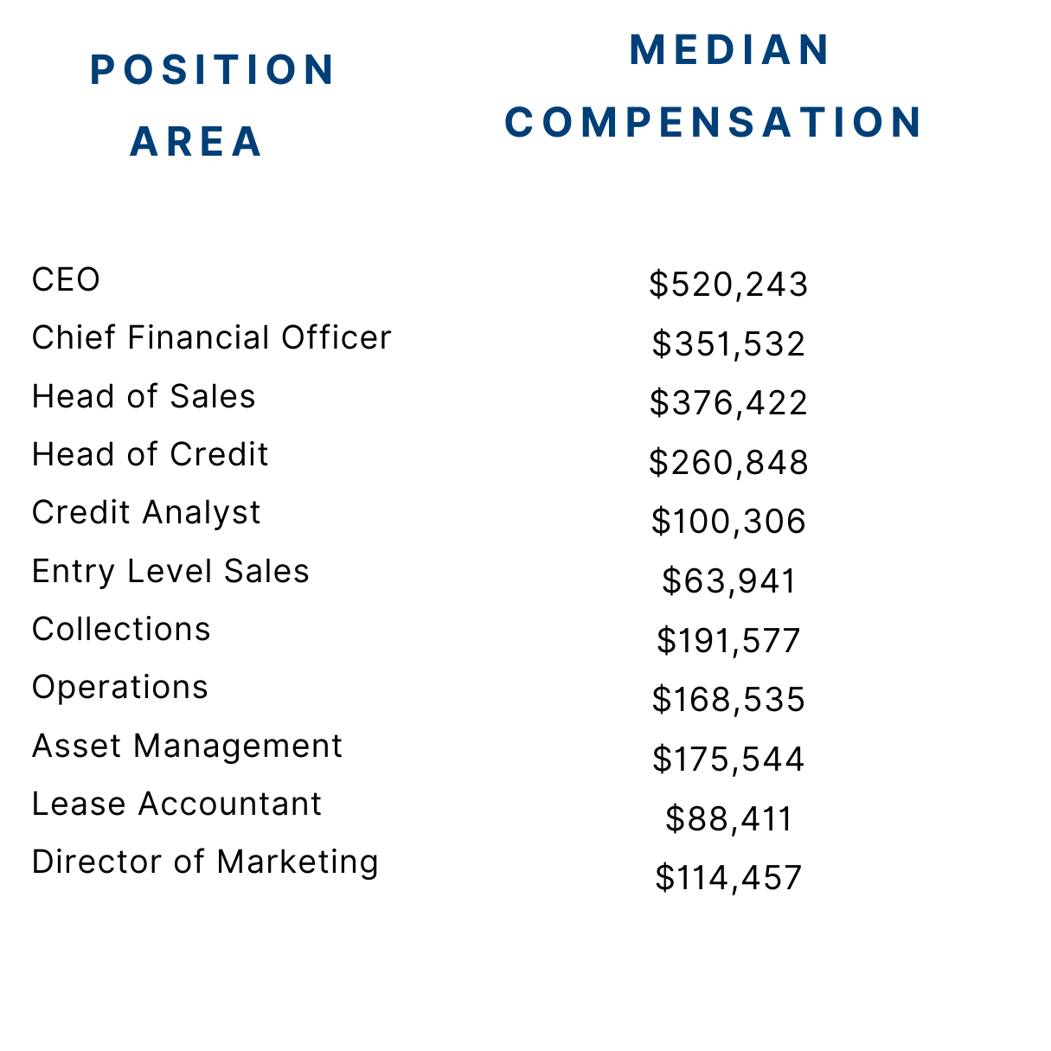
COMPENSATION FOR SMALL AND MEDIUM SIZE BUSINESS
Source: 2024Equipment Leasing & Finance Compensation Survey

Slide 24

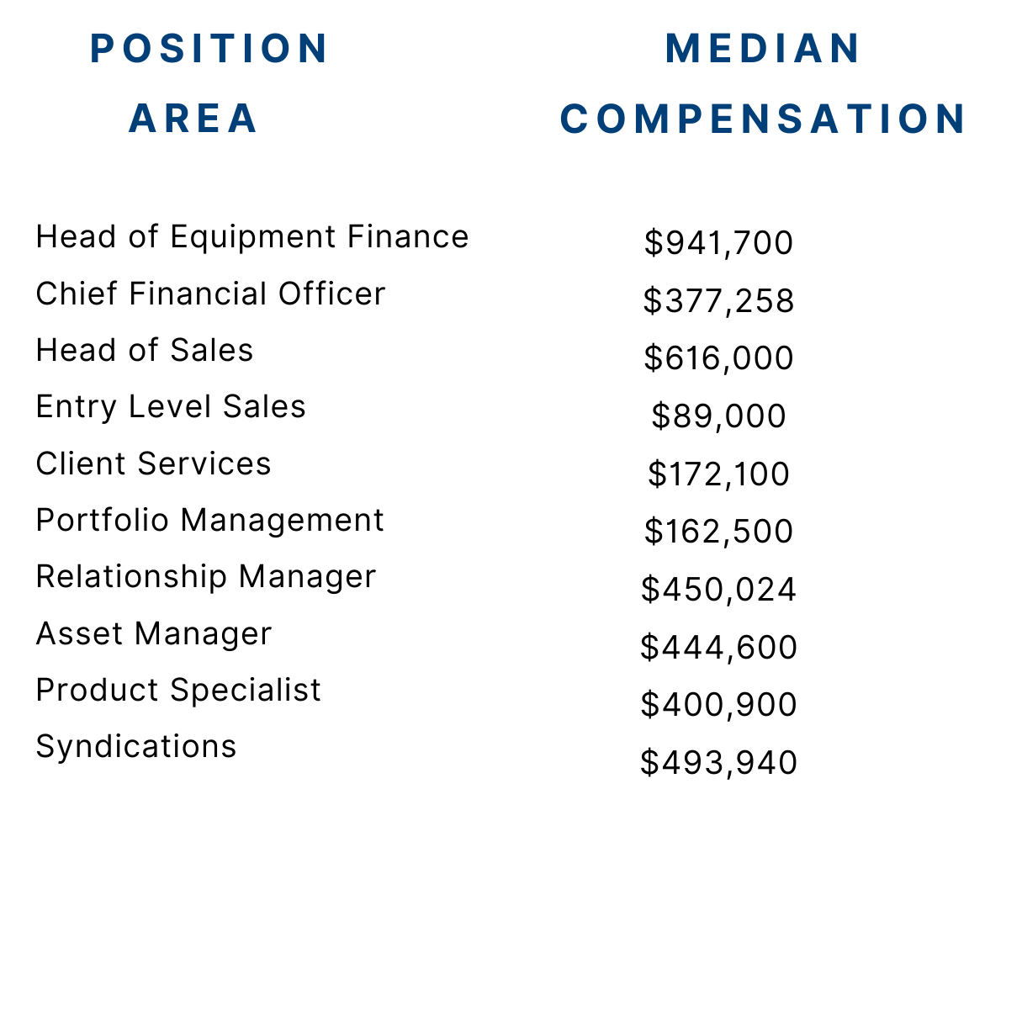
COMPENSATION FOR LARGE BUSINESS
Source: 2023 Equipment Leasing & Finance Compensation Survey

Slide 25


Slide 26
QUESTIONS?

